Slide 1

The Nintendo
A Case Study in Retro Emulation
Frédéric Hamel
Programming Technical Director at Behaviour Interactive

Slide 2

The Plan
Introduction
General emulation principles
Game Boy hardware overview
Overview of an emulator I wrote
This talk alternates between general Game Boy emulation and a more specific focus on C++.
If you have questions, great! Please note the slide number and we’ll circle back at the end!
These slides are published here: https://goo.gl/jQQY3c
Notes:
Quite a tight schedule - even if I talk fast, there is a lot to cover :-)

Slide 3

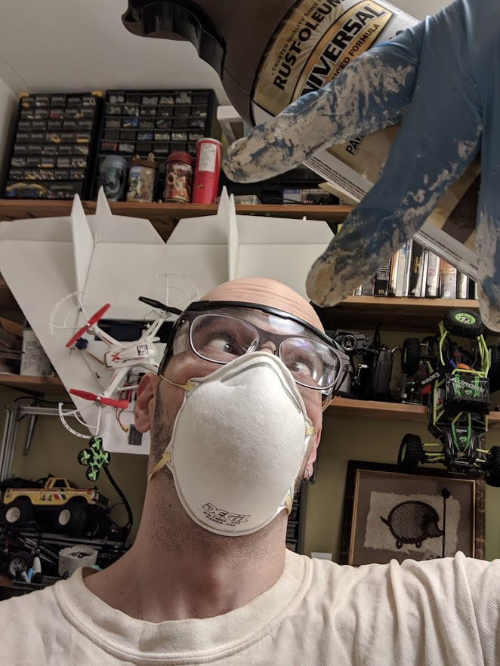















Who I Am
Graduated in 2004 in computer engineering at the University of Waterloo​
As a programmer, I’ve worked for Atari/Infogrames, Electronic Arts, Eidos Montréal, Minority, and Behaviour​
Since 2014, I’ve been a technical director for Behaviour​

Slide 4
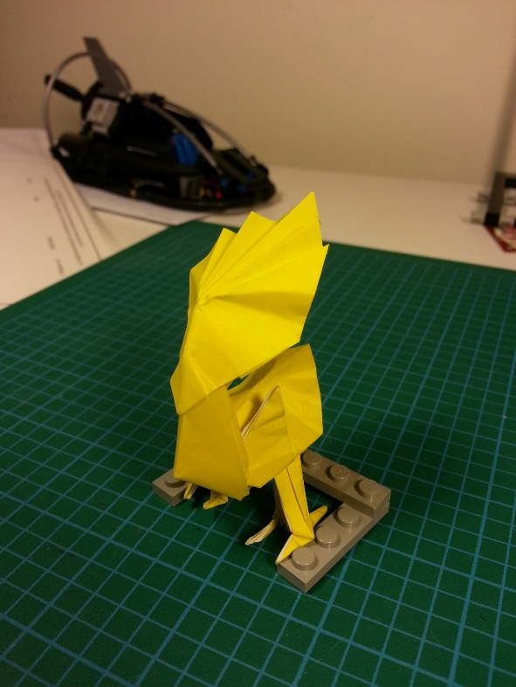
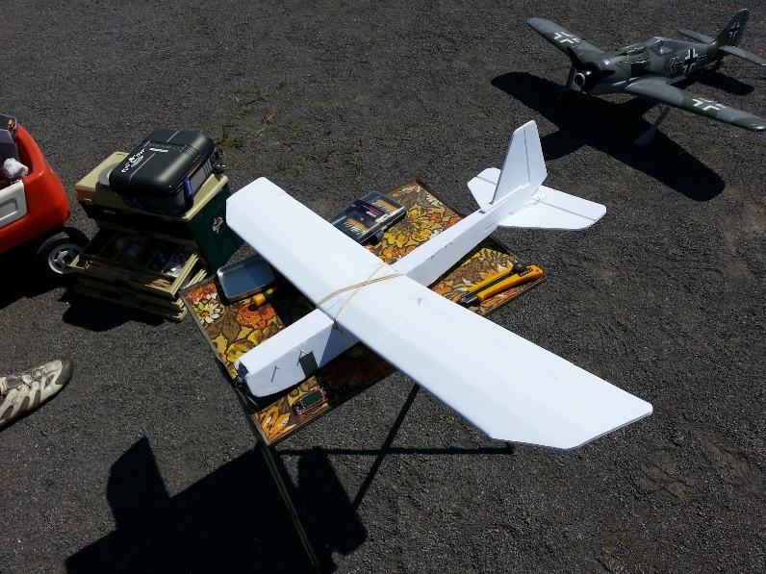
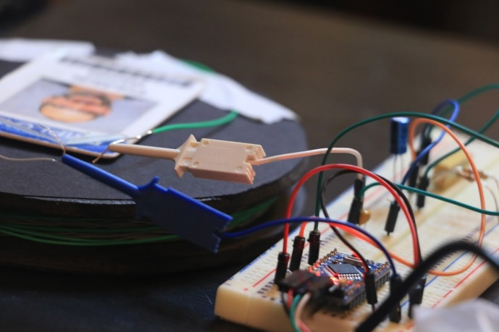
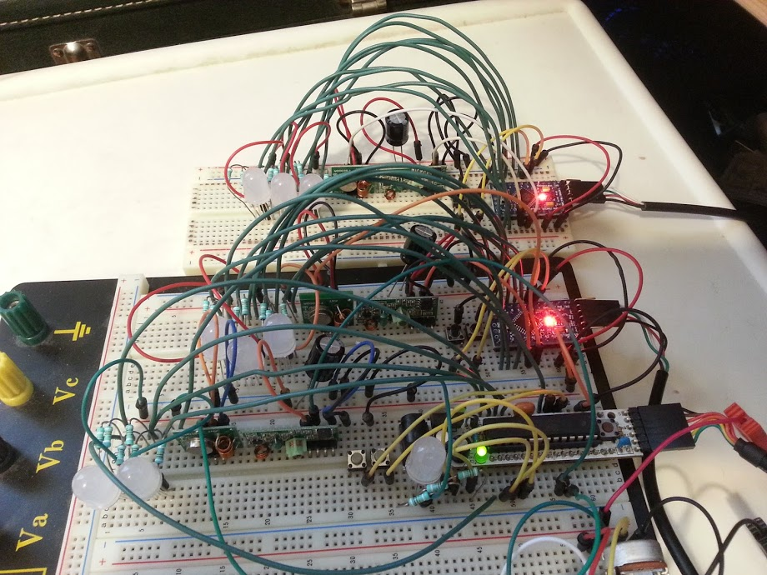
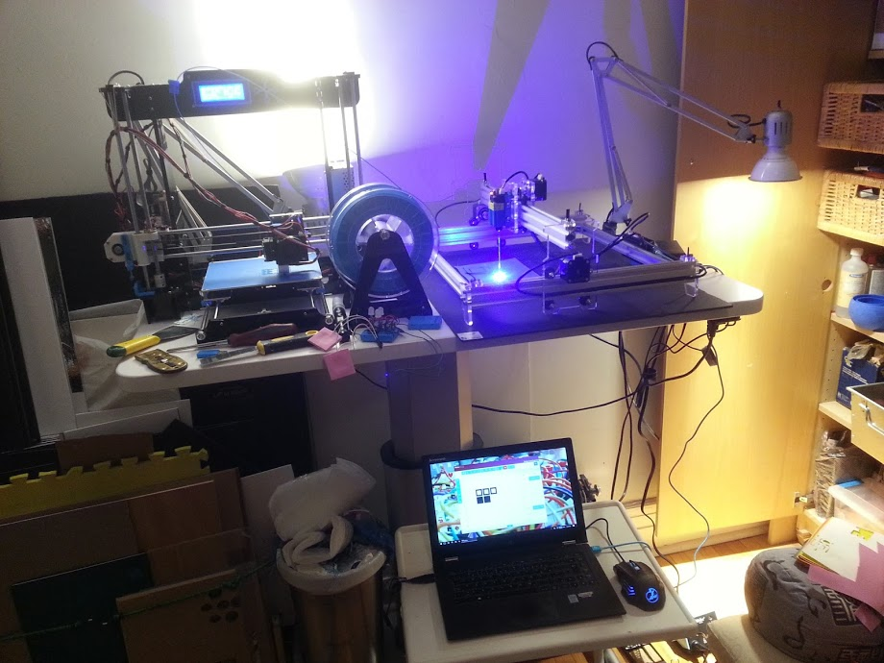
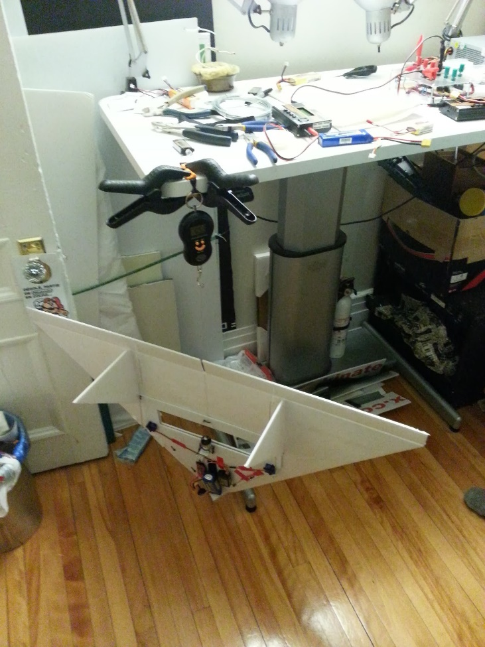
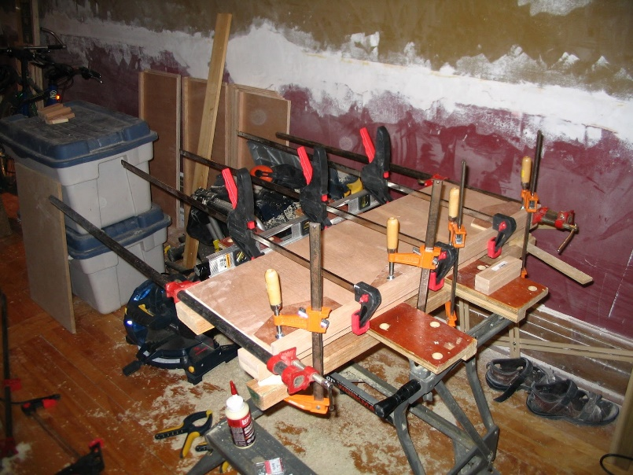
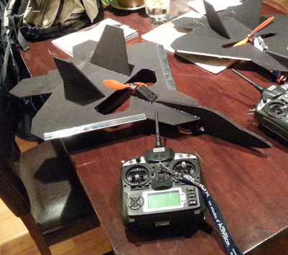
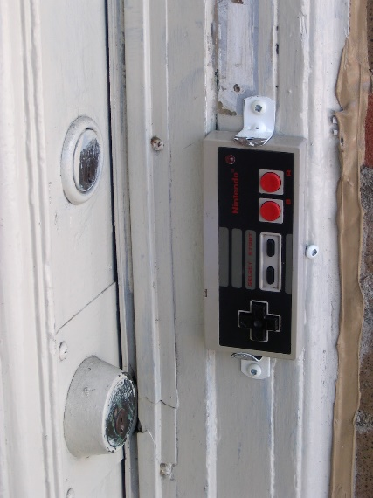
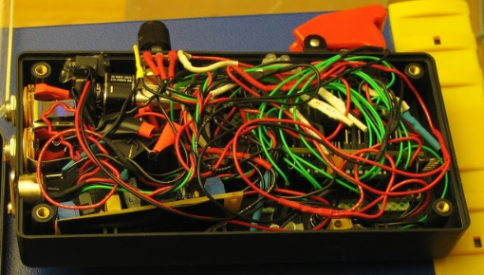
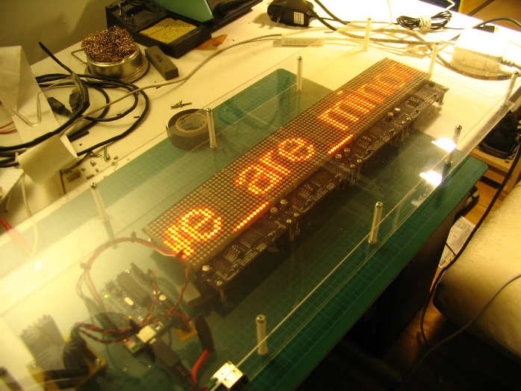
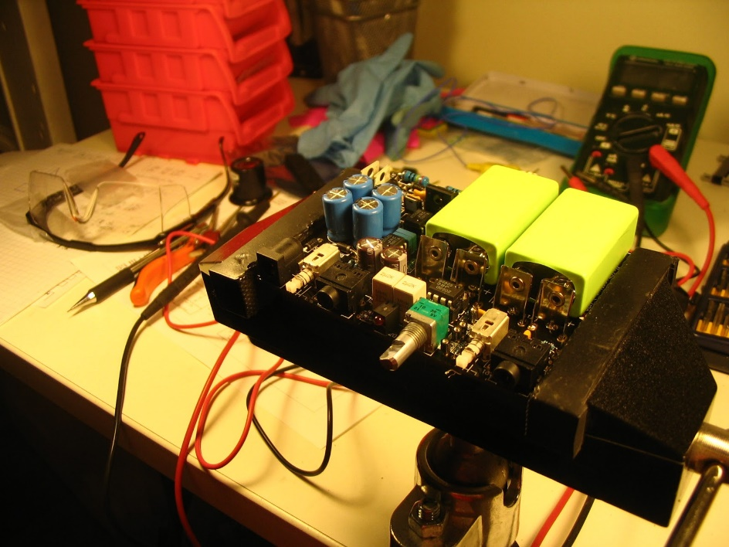
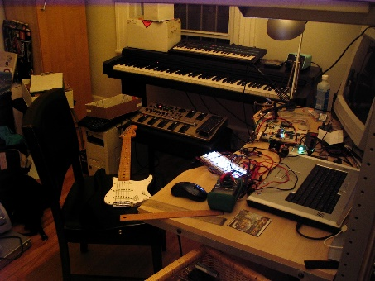
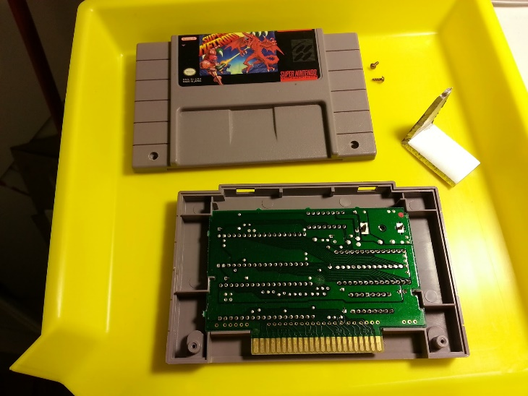

Slide 5
What is an Emulator?
According to Wikipedia:
In computing, an emulator is hardware or software that enables one computer system (called the host) to behave like another computer system (called the guest).
Our guest is of course the Game Boy, and our main host of concern is the Windows PC
The emulator is fairly portable; it uses Simple DirectMedia Layer (SDL)
Note that I was concerned with the original DMG-01 only; I did not attempt to emulate the Game Boy Color or the Super Game Boy
Unless otherwise specified, this talk concerns software emulators
Notes:
Wikipedia: an emulator typically enables the host system to run software or use peripheral devices designed for the guest system.
Windows PC but emulator itself should be reasonably portable

Slide 6
How to Emulate a System
Step 1: understand how the system works
Reading publicly-available documentation...
…or usually, lots of reverse engineering
Step 2: develop an emulator based on the rules of the system
Typically software
Occasionally firmware-based, e.g. firmware on an FPGA
Rarely hardware, but it happens

Slide 7
Why a Game Boy Emulator?
Mainly, it’s relatively well-documented
Quite simple with only a few quirks, so it’s a reasonably well self-contained project
Compared to e.g. the NES’s PPU, the Game Boy LCD controller is much simpler
I owned one along with many games
Notes:
Friends were writing emulators at the time and it looked like fun.
I recommend the DMG-01 as a starting point if you’re looking to get into writing emulators.

Slide 8
Credit Where Credit is Due
I started from widely-available specification docs
“Pan docs” are a great start and the most frequently-quoted reference
DP’s Game Boy CPU Manual for more detail about the CPU opcodes
Very recently, AntonioND’s Cycle-Accurate Game Boy Docs (2015+) and GameBoy-Online to find my last known execution bugs
I did very little if any hardware reverse-engineering
But I did discover (apparently novel) evidence of an unsold rotary controller peripheral that worked with the Game Link port!
Notes:
AntonioND: the fact that people are still trying to understand details about the hardware of such a simple system more than 25 years after its launch gives an indication of the difficulty inherent to emulating systems

Slide 9
More Credit
In order to run an emulator, you need at least one ROM image
I spent lots of time with blargg’s excellent suite of test ROMs
...and moved on

Slide 10
The Game Boy
The Game Boy
The CPU
The Memory Bus
Cartridges and ROM
The Joypad
The LCD Controller
The Sound Controller
Other Bits

Slide 11
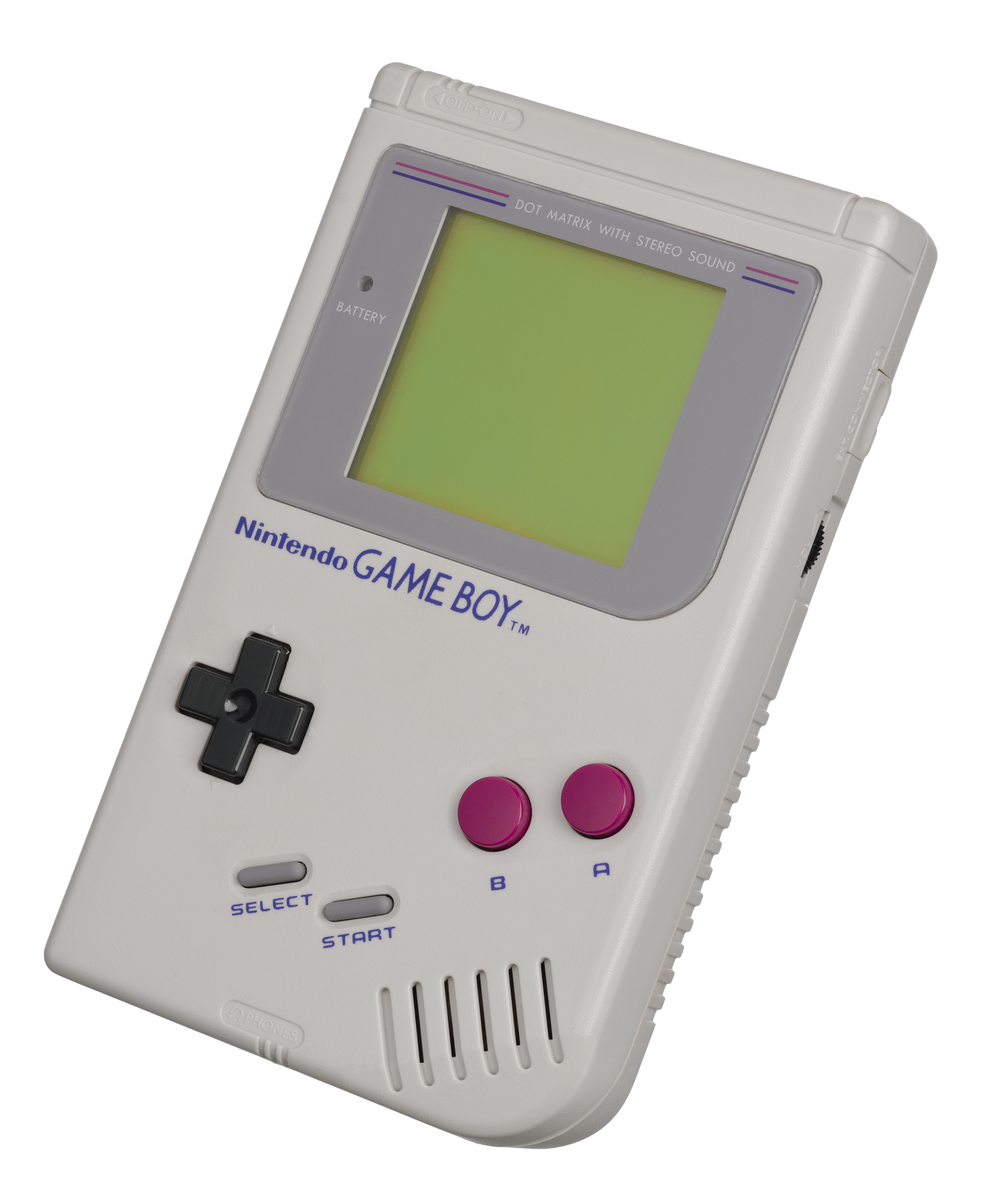
Game Boy Hardware Overview
Battery indicator
LCD screen
Directional
Pad
Select / Start Buttons
A / B Buttons
Speaker
Notes:
How many of you have held a physical Game Boy in the last year?

Slide 12
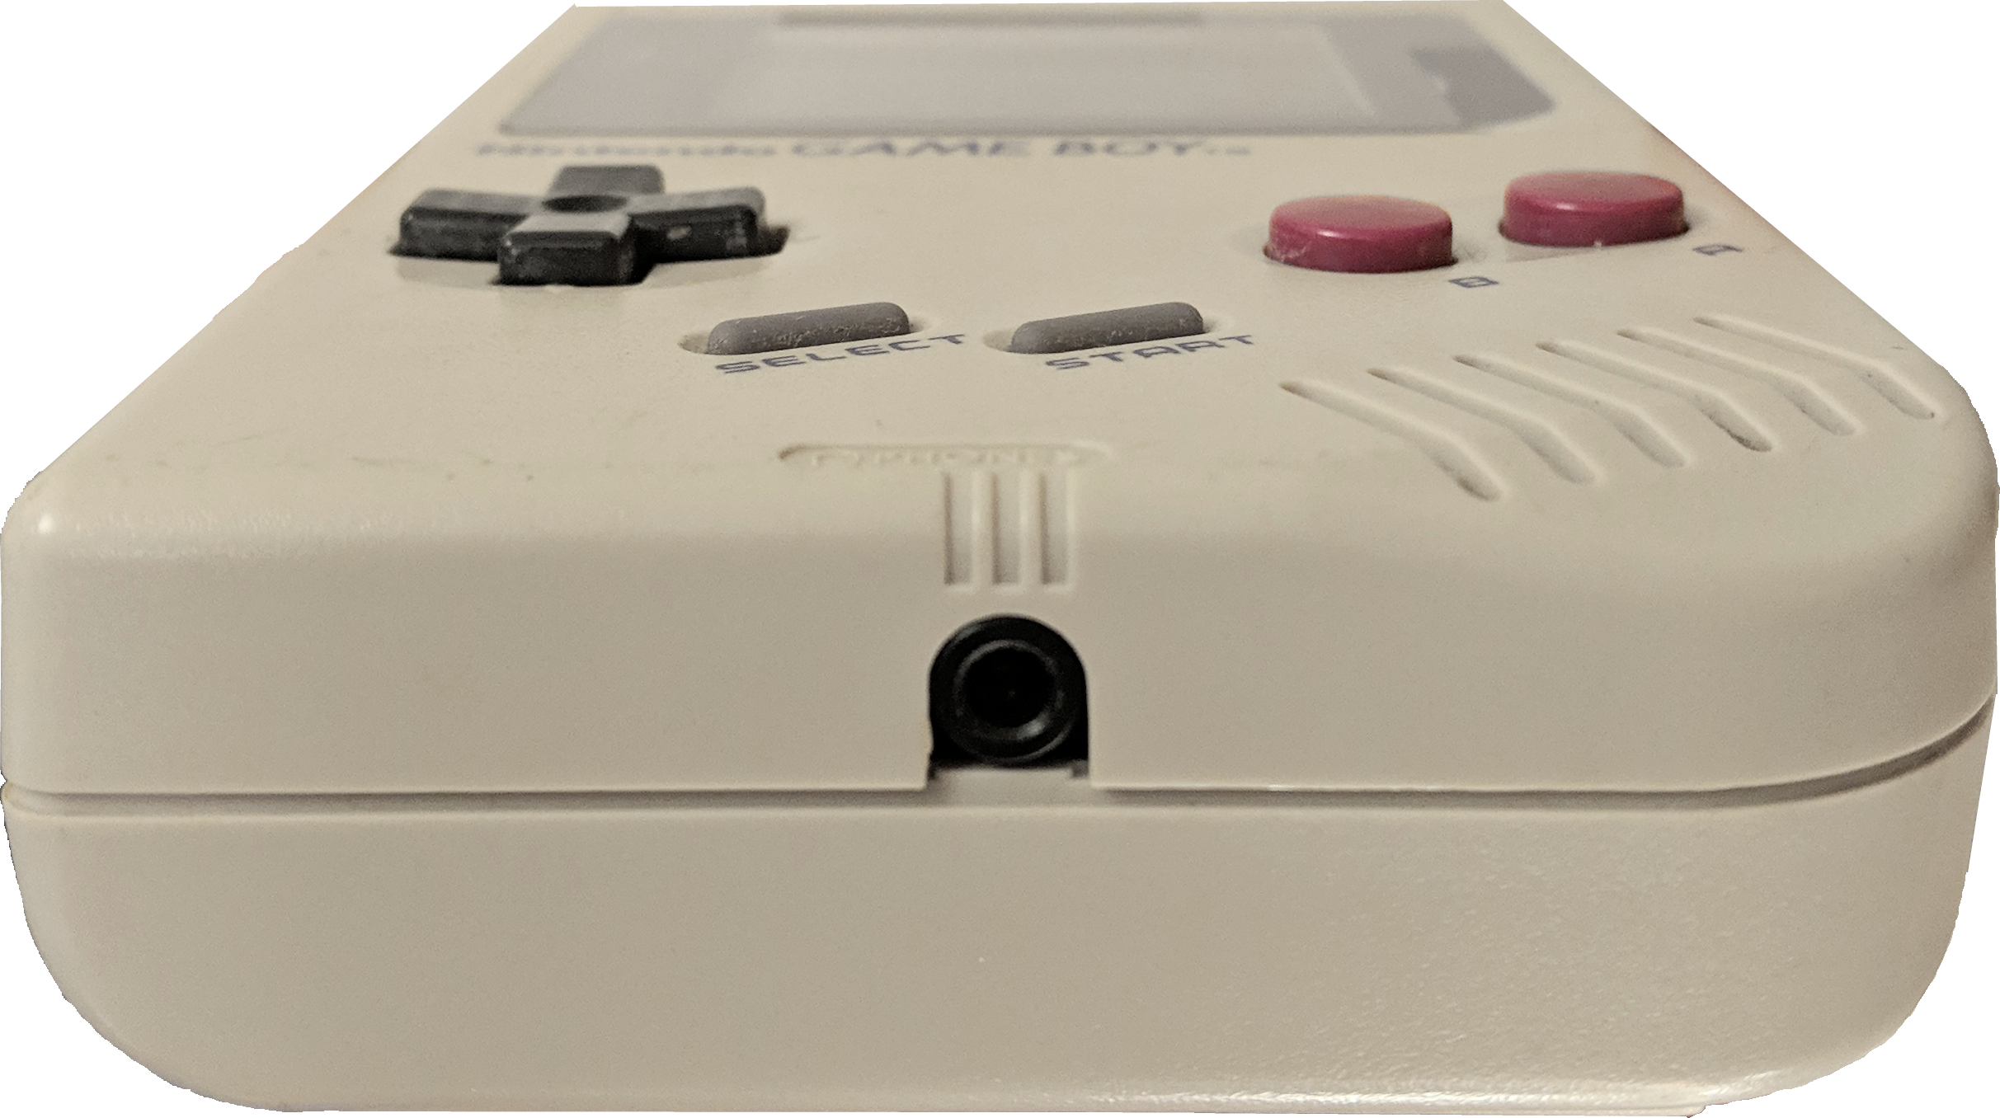
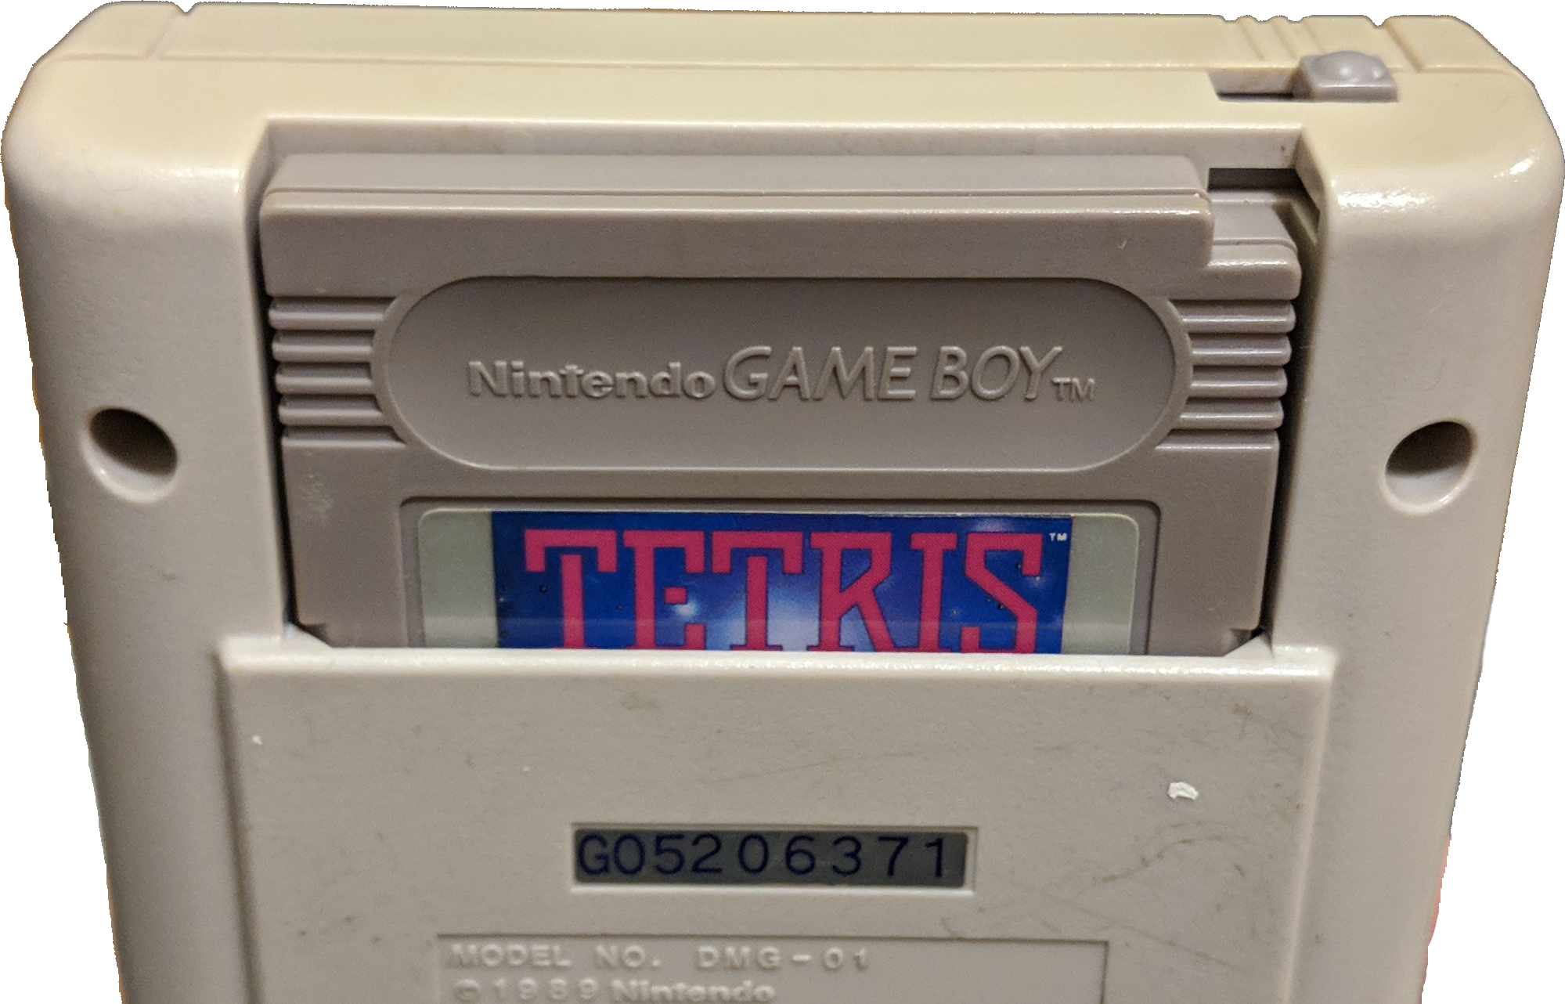
Game Boy Hardware Overview (cont’d)
Cartridge Slot
Power Switch
Headphone Jack

Slide 13
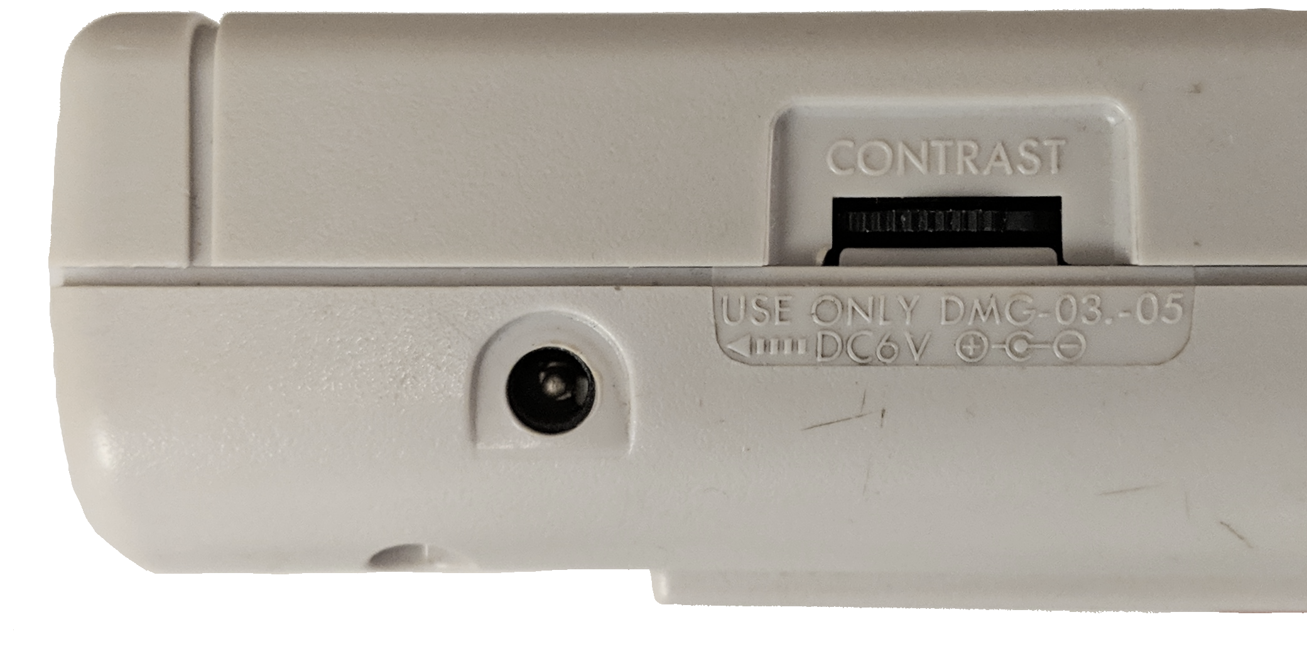
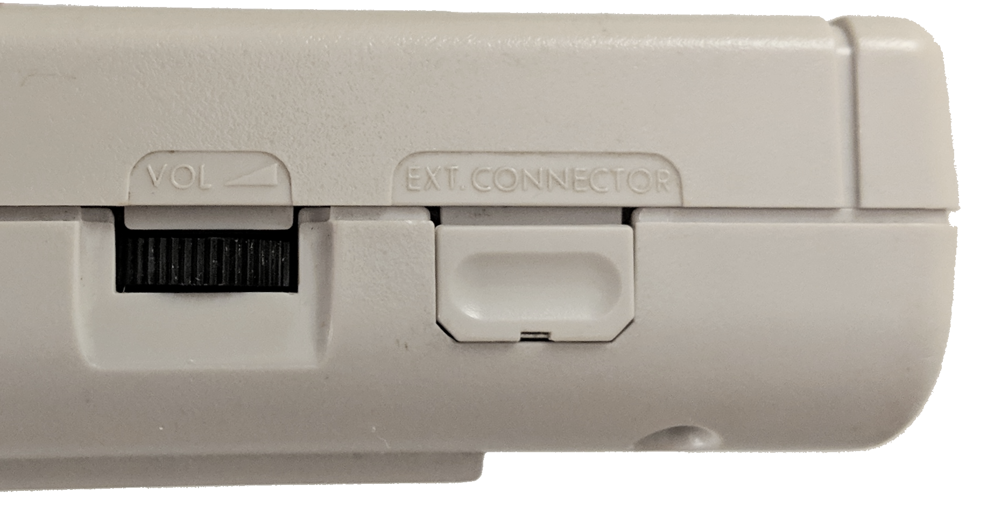
Game Boy Hardware Overview (cont’d)
External Power Input
LCD Contrast Adjustment
Volume Adjustment
Game Link Port

Slide 14
Hardware Specs
CPU: 8-bit Sharp LR35902, similar to Intel 8080 with some Z80 goodies
Master clock speed: ~4 MHz
CPU: ~1 MIPS (~4 clocks per instruction)
8KiB of RAM
8KiB of video RAM (VRAM)
Cartridge size: 32KiB ROM, up to 2MiB ROM with an extra 32KiB of RAM
Notes:
10-15 normal 5mm LEDs at full brightness

Slide 15
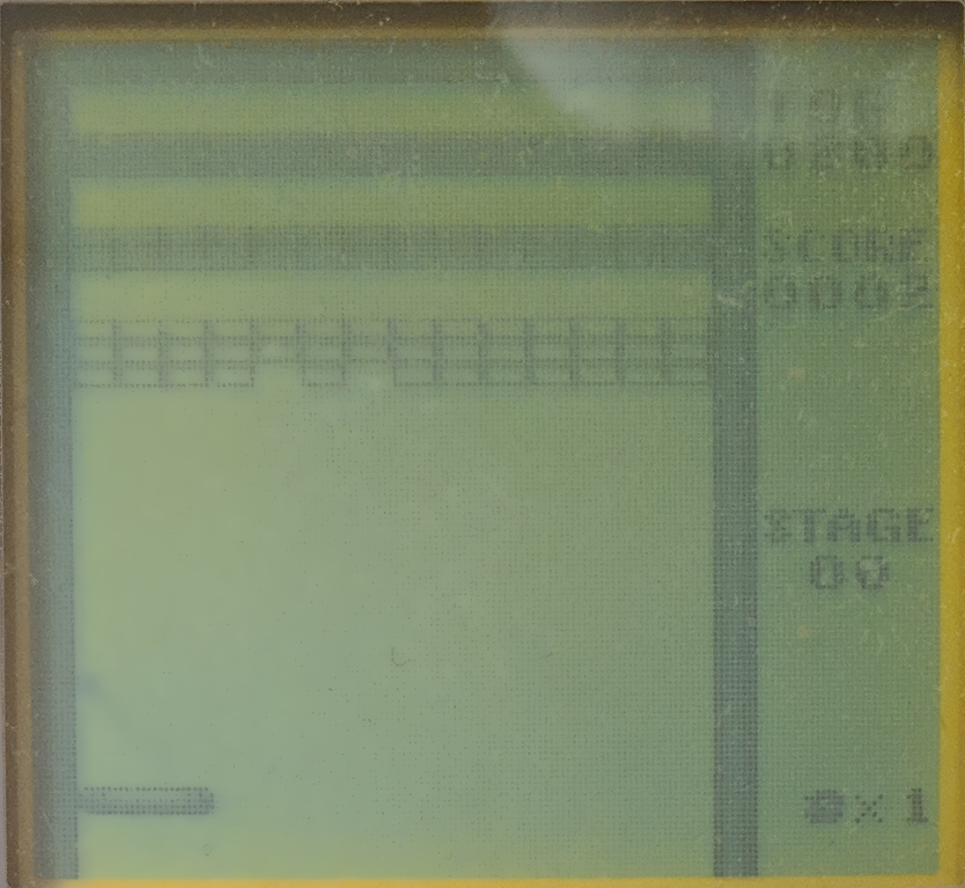

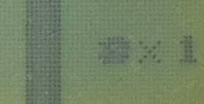
Hardware Specs (cont’d)
160 pixels
LCD: 160x144, or 20x18 tiles of 8x8 pixels; 59.7 FPS
Sprites: max 40 per screen, 10 per horizontal line of pixels
4 grayscale colors
Sound: 4-channel stereo
Power consumption: 0.7W
144
pixels
20 8x8 tiles
18 8x8 tiles
Notes:
10-15 normal 5mm LEDs at full brightness

Slide 16
My Goals for this Project
Clarity and correctness first, speed second
Except for CPU - I wanted to try some compile-time techniques to reduce code duplication; this turned out elegant but somewhat opaque
Have fun
Learn about the hardware
Try out some C++ ideas
Most of the emulator was written in C++11 around the end of 2014
Accuracy is important but there are diminishing returns
Not looking to replace great emulators like Gambatte or bgb

Slide 17
Emulation Strategies
Lower-level emulation
More accuracy
Slower
Higher-level emulation
Less accuracy
Faster
Physical-level emulation: emulating signals, circuit internals, exact sub-instruction clock counts
Example: Higan
Low-level emulation: emulating CPU instructions atomically, respecting the documented hardware limits but not emulating the inside of the circuitry perfectly
Most emulators, including this one
High-level emulation: for modern systems that only provide an API with scant hardware access, emulation of API endpoints can be sufficient (fifth/sixth generation of consoles and on)
Example: UltraHLE, WINE
Notes:
The fact that games are now highly-abstracted, even on console, and that they must run on multiple hardware SKUs without modification (e.g. PS4 vs PS4 Pro) generally helps emulation by discouraging weird hardware tricks

Slide 18
Real-Time Interactive Software
Unlike much event-driven or utility software, interactive software tends to contain an “update loop”
Generally, instead of reacting to outside events (program start, button clicks, etc.) the update loop executes repeatedly, as fast as possible
Notes:
Many generalizations here

Slide 19
A Typical Update Loop
while (!done)
{
}
simulate(t) // reacts to input, advances time of simulation
render() // produces picture and sound using current simulation state
read input
t = time elapsed during last iteration of this loop
Read Input
Simulate
Render
This produces a maximal number of images per second, with minimal time spent between user input and a visible or audible result.
Notes:
This is a single-threaded update loop
Modern games are usually more complex than this

Slide 20
The Emulator’s Main Loop
while (!done) {
SDL_Event event;
while (SDL_PollEvent(&event)) {
switch (event.type) {
...
case SDL_QUIT: done = true; break;
}
}
...
auto seconds = elapsedMicroseconds / 1000000.0f;
if (!paused) gb.Update(seconds);
SDL_RenderClear(pRenderer.get());
SDL_RenderCopy(pRenderer.get(), gb.GetFrontFrameBufferTexture(), NULL, NULL);
SDL_RenderPresent(pRenderer.get());
}
Read input
Simulate (update)
This is where the magic is.
Render

Slide 21
The Game Boy Update
void Update(float seconds) {
m_cyclesRemaining += seconds * MemoryBus::kCyclesPerSecond;
while (m_cyclesRemaining > 0) {
auto cyclesUsed = m_pCpu->ExecuteSingleInstruction();
m_cyclesRemaining -= cyclesUsed;
const float secondsPerClockCycle = 1.0f / MemoryBus::kCyclesPerSecond;
auto secondsSpentOnInstruction = secondsPerClockCycle * cyclesUsed;
m_pTimer->Update(secondsSpentOnInstruction);
m_pJoypad->Update(secondsSpentOnInstruction);
m_pLcd->Update(secondsSpentOnInstruction);
m_pSound->Update(secondsSpentOnInstruction);
m_pGameLinkPort->Update(secondsSpentOnInstruction);
}
}
Repeat until all update time exhausted
Emulate one instruction
Convert the number of cycles used by the instruction into seconds
Update all devices with the time spent on the CPU instruction
Notes:
Talk about coroutines?

Slide 22
Game Boy System Diagram
CPU
Cartridge (RAM/ROM)
Joypad Input
LCD
Sound
Timer
DMA
Game Link Port
Memory Bus
(16-bit addresses - 65,536 byte-sized words)
On the Game Boy, everything is memory-mapped
Von Neumann architecture, like x86 and ARM
No distinction between code and data; they are in the same memory
To talk to devices, the CPU reads and writes from memory addresses
Every device has a set of dedicated addresses
For example, to read the state of the buttons, the CPU reads address 0xFF00

Slide 23
The Emulator
CPU
Cartridge (RAM/ROM)
Joypad Input
LCD
Sound
Timer
DMA
Game Link Port
I chose to organize my emulator by device; there is roughly one class per device
Let’s go through them one by one
Notes:
This is not necessarily a common choice. A lot of emulators go for a lower-level C-style implementation.

Slide 24
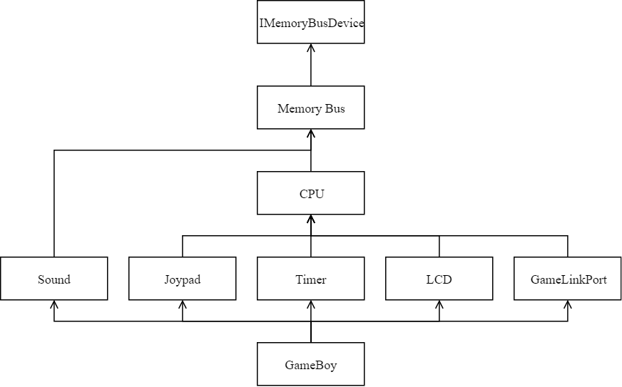
Quick Note - Code Organization
Most emulator code is in headers with #pragma once guards
The vast majority of functions are defined directly inline, in the class declaration
Because of the header guards, there is a strict ordering of dependencies; the dependency graph cannot contain cycles, which reduces coupling
No need to forward-declare any functions or members

Slide 25
Quick Note - Code Organization
Only one .cpp file is marked for compilation; it includes all the header code along with a few other things
As is typical of such unity/glob builds, all code is seen exactly once and only once by the compiler via the main translation unit
Reasonable iteration time for a C++ program; a full release rebuild takes ~5 seconds on an 8+ year-old computer
So do incrementals, however :-)

Slide 26
The CPU
The Game Boy
The CPU
The Memory Bus
Cartridges and ROM
The Joypad
The LCD Controller
The Sound Controller
Other Bits

Slide 27
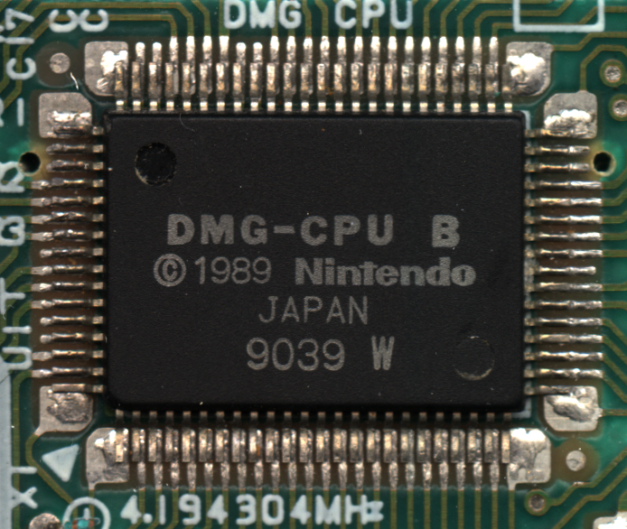
The CPU - Opcode Families
Relatively simple instruction set
Transfers: LD, LDI, PUSH, POP
Arithmetic: ADD/ADC, SUB/SBC, CP, INC, DEC, DAA
Bitwise operations: AND, XOR, OR, CPL, RLCA/RLA, RRCA/RRA, RLC/RL, RRC/RR, SLA, SRA, SWAP, SRL, BIT, SET, RES
Flow control: JP, JR, CALL, RET, RETI, RST
Misc: CCF, SCF, NOP, HALT, STOP, DI, EI
Vast majority of instructions work with 8-bit operands, but a select few work with 16 bits
All 16-bit instructions are longer to execute; they are internally decomposed into 8-bit operations
Image source: https://wornwinter.wordpress.com/2015/02/14/adventures-in-gameboy-emulation-part-2-the-cpu/

Slide 28
The CPU - Register Layout
Few registers
8-bit: A (accumulator), B, C, D, E, H, L, F (flags)
16-bit: PC (program counter), SP (stack pointer)
16-bit memory interface means 65,536 addressable 8-bit words
When the Game Boy starts, the CPU “effectively” starts reading and executing opcodes at address 256 (0x0100) in memory
The first 256 bytes are occupied by a boot ROM that takes care of copy protection
Notes:
Air quotes; boot sequence is more complex than this in practice

Slide 29
Opcodes
The CPU does the following:
Fetch the opcode at the address pointed to by PC
Fetch any required operands for that opcode and advance PC accordingly
Execute the opcode
Repeat
The first byte in each opcode tells the CPU what to do
The bytes that follow contain any required operands, such as an address or an immediate value (little endian)
Address | 0x0100 | 0x0101 | 0x0102 | 0x0103 | 0x0104 | 0x0105 | 0x0106
Value | 0x23 | 0x80 | 0xC6 | 0xFF | 0xEA | 0x04 | 0xC0

Slide 30
Opcodes
The CPU does the following:
Fetch the opcode at the address pointed to by PC
Fetch any required operands for that opcode and advance PC accordingly
Execute the opcode
Repeat
The first byte in each opcode tells the CPU what to do
The bytes that follow contain any required operands, such as an address or an immediate value (little endian)
Address | 0x0100 | 0x0101 | 0x0102 | 0x0103 | 0x0104 | 0x0105 | 0x0106
Value | 0x23 | 0x80 | 0xC6 | 0xFF | 0xEA | 0x04 | 0xC0
Meaning | INC HL | ADD A,B | ADD A,n | n | LD (nn),A | nn low byte | nn high byte

Slide 31
Opcode Table
 | x0 | x1 | x2 | x3 | x4 | x5 | x6 | x7 | x8 | x9 | xA | xB | xC | xD | xE | xF
0x | NOP | LD BC,nn | LD (BC),A | INC BC | INC B | DEC B | LD B,n | RLC A | LD (nn),SP | ADD HL,BC | LD A,(BC) | DEC BC | INC C | DEC C | LD C,n | RRC A
1x | STOP | LD DE,nn | LD (DE),A | INC DE | INC D | DEC D | LD D,n | RL A | JR n | ADD HL,DE | LD A,(DE) | DEC DE | INC E | DEC E | LD E,n | RR A
2x | JR NZ,n | LD HL,nn | LDI (HL),A | INC HL | INC H | DEC H | LD H,n | DAA | JR Z,n | ADD HL,HL | LDI A,(HL) | DEC HL | INC L | DEC L | LD L,n | CPL
3x | JR NC,n | LD SP,nn | LDD (HL),A | INC SP | INC (HL) | DEC (HL) | LD (HL),n | SCF | JR C,n | ADD HL,SP | LDD A,(HL) | DEC SP | INC A | DEC A | LD A,n | CCF
4x | LD B,B | LD B,C | LD B,D | LD B,E | LD B,H | LD B,L | LD B,(HL) | LD B,A | LD C,B | LD C,C | LD C,D | LD C,E | LD C,H | LD C,L | LD C,(HL) | LD C,A
5x | LD D,B | LD D,C | LD D,D | LD D,E | LD D,H | LD D,L | LD D,(HL) | LD D,A | LD E,B | LD E,C | LD E,D | LD E,E | LD E,H | LD E,L | LD E,(HL) | LD E,A
6x | LD H,B | LD H,C | LD H,D | LD H,E | LD H,H | LD H,L | LD H,(HL) | LD H,A | LD L,B | LD L,C | LD L,D | LD L,E | LD L,H | LD L,L | LD L,(HL) | LD L,A
7x | LD (HL),B | LD (HL),C | LD (HL),D | LD (HL),E | LD (HL),H | LD (HL),L | HALT | LD (HL),A | LD A,B | LD A,C | LD A,D | LD A,E | LD A,H | LD A,L | LD A,(HL) | LD A,A
8x | ADD A,B | ADD A,C | ADD A,D | ADD A,E | ADD A,H | ADD A,L | ADD A,(HL) | ADD A,A | ADC A,B | ADC A,C | ADC A,D | ADC A,E | ADC A,H | ADC A,L | ADC A,(HL) | ADC A,A
9x | SUB A,B | SUB A,C | SUB A,D | SUB A,E | SUB A,H | SUB A,L | SUB A,(HL) | SUB A,A | SBC A,B | SBC A,C | SBC A,D | SBC A,E | SBC A,H | SBC A,L | SBC A,(HL) | SBC A,A
Ax | AND B | AND C | AND D | AND E | AND H | AND L | AND (HL) | AND A | XOR B | XOR C | XOR D | XOR E | XOR H | XOR L | XOR (HL) | XOR A
Bx | OR B | OR C | OR D | OR E | OR H | OR L | OR (HL) | OR A | CP B | CP C | CP D | CP E | CP H | CP L | CP (HL) | CP A
Cx | RET NZ | POP BC | JP NZ,nn | JP nn | CALL NZ,nn | PUSH BC | ADD A,n | RST 0 | RET Z | RET | JP Z,nn | Ext ops | CALL Z,nn | CALL nn | ADC A,n | RST 8
Dx | RET NC | POP DE | JP NC,nn | XX | CALL NC,nn | PUSH DE | SUB A,n | RST 10 | RET C | RETI | JP C,nn | XX | CALL C,nn | XX | SBC A,n | RST 18
Ex | LDH (n),A | POP HL | LDH (C),A | XX | XX | PUSH HL | AND n | RST 20 | ADD SP,d | JP (HL) | LD (nn),A | XX | XX | XX | XOR n | RST 28
Fx | LDH A,(n) | POP AF | LDH A,(C) | DI | XX | PUSH AF | OR n | RST 30 | LDHL SP,d | LD SP,HL | LD A,(nn) | EI | XX | XX | CP n | RST 38
 | x0 | x1 | x2 | x3 | x4 | x5 | x6 | x7 | x8 | x9 | xA | xB | xC | xD | xE | xF
0x | RLC B | RLC C | RLC D | RLC E | RLC H | RLC L | RLC (HL) | RLC A | RRC B | RRC C | RRC D | RRC E | RRC H | RRC L | RRC (HL) | RRC A
1x | RL B | RL C | RL D | RL E | RL H | RL L | RL (HL) | RL A | RR B | RR C | RR D | RR E | RR H | RR L | RR (HL) | RR A
2x | SLA B | SLA C | SLA D | SLA E | SLA H | SLA L | SLA (HL) | SLA A | SRA B | SRA C | SRA D | SRA E | SRA H | SRA L | SRA (HL) | SRA A
3x | SWAP B | SWAP C | SWAP D | SWAP E | SWAP H | SWAP L | SWAP (HL) | SWAP A | SRL B | SRL C | SRL D | SRL E | SRL H | SRL L | SRL (HL) | SRL A
4x | BIT 0,B | BIT 0,C | BIT 0,D | BIT 0,E | BIT 0,H | BIT 0,L | BIT 0,(HL) | BIT 0,A | BIT 1,B | BIT 1,C | BIT 1,D | BIT 1,E | BIT 1,H | BIT 1,L | BIT 1,(HL) | BIT 1,A
5x | BIT 2,B | BIT 2,C | BIT 2,D | BIT 2,E | BIT 2,H | BIT 2,L | BIT 2,(HL) | BIT 2,A | BIT 3,B | BIT 3,C | BIT 3,D | BIT 3,E | BIT 3,H | BIT 3,L | BIT 3,(HL) | BIT 3,A
6x | BIT 4,B | BIT 4,C | BIT 4,D | BIT 4,E | BIT 4,H | BIT 4,L | BIT 4,(HL) | BIT 4,A | BIT 5,B | BIT 5,C | BIT 5,D | BIT 5,E | BIT 5,H | BIT 5,L | BIT 5,(HL) | BIT 5,A
7x | BIT 6,B | BIT 6,C | BIT 6,D | BIT 6,E | BIT 6,H | BIT 6,L | BIT 6,(HL) | BIT 6,A | BIT 7,B | BIT 7,C | BIT 7,D | BIT 7,E | BIT 7,H | BIT 7,L | BIT 7,(HL) | BIT 7,A
8x | RES 0,B | RES 0,C | RES 0,D | RES 0,E | RES 0,H | RES 0,L | RES 0,(HL) | RES 0,A | RES 1,B | RES 1,C | RES 1,D | RES 1,E | RES 1,H | RES 1,L | RES 1,(HL) | RES 1,A
9x | RES 2,B | RES 2,C | RES 2,D | RES 2,E | RES 2,H | RES 2,L | RES 2,(HL) | RES 2,A | RES 3,B | RES 3,C | RES 3,D | RES 3,E | RES 3,H | RES 3,L | RES 3,(HL) | RES 3,A
Ax | RES 4,B | RES 4,C | RES 4,D | RES 4,E | RES 4,H | RES 4,L | RES 4,(HL) | RES 4,A | RES 5,B | RES 5,C | RES 5,D | RES 5,E | RES 5,H | RES 5,L | RES 5,(HL) | RES 5,A
Bx | RES 6,B | RES 6,C | RES 6,D | RES 6,E | RES 6,H | RES 6,L | RES 6,(HL) | RES 6,A | RES 7,B | RES 7,C | RES 7,D | RES 7,E | RES 7,H | RES 7,L | RES 7,(HL) | RES 7,A
Cx | SET 0,B | SET 0,C | SET 0,D | SET 0,E | SET 0,H | SET 0,L | SET 0,(HL) | SET 0,A | SET 1,B | SET 1,C | SET 1,D | SET 1,E | SET 1,H | SET 1,L | SET 1,(HL) | SET 1,A
Dx | SET 2,B | SET 2,C | SET 2,D | SET 2,E | SET 2,H | SET 2,L | SET 2,(HL) | SET 2,A | SET 3,B | SET 3,C | SET 3,D | SET 3,E | SET 3,H | SET 3,L | SET 3,(HL) | SET 3,A
Ex | SET 4,B | SET 4,C | SET 4,D | SET 4,E | SET 4,H | SET 4,L | SET 4,(HL) | SET 4,A | SET 5,B | SET 5,C | SET 5,D | SET 5,E | SET 5,H | SET 5,L | SET 5,(HL) | SET 5,A
Fx | SET 6,B | SET 6,C | SET 6,D | SET 6,E | SET 6,H | SET 6,L | SET 6,(HL) | SET 6,A | SET 7,B | SET 7,C | SET 7,D | SET 7,E | SET 7,H | SET 7,L | SET 7,(HL) | SET 7,A
Notes:
...and another page like this for the extended opcodes

Slide 32
CPU C++ Implementation
Many emulators implement each opcode individually, resulting in a large amount of similar but not-quite-copy-pasted code
By using templates, I was able to dramatically cut down on the amount of code duplication

Slide 33
Opcode Table
 | x0 | x1 | x2 | x3 | x4 | x5 | x6 | x7 | x8 | x9 | xA | xB | xC | xD | xE | xF
0x | NOP | LD BC,nn | LD (BC),A | INC BC | INC B | DEC B | LD B,n | RLC A | LD (nn),SP | ADD HL,BC | LD A,(BC) | DEC BC | INC C | DEC C | LD C,n | RRC A
1x | STOP | LD DE,nn | LD (DE),A | INC DE | INC D | DEC D | LD D,n | RL A | JR n | ADD HL,DE | LD A,(DE) | DEC DE | INC E | DEC E | LD E,n | RR A
2x | JR NZ,n | LD HL,nn | LDI (HL),A | INC HL | INC H | DEC H | LD H,n | DAA | JR Z,n | ADD HL,HL | LDI A,(HL) | DEC HL | INC L | DEC L | LD L,n | CPL
3x | JR NC,n | LD SP,nn | LDD (HL),A | INC SP | INC (HL) | DEC (HL) | LD (HL),n | SCF | JR C,n | ADD HL,SP | LDD A,(HL) | DEC SP | INC A | DEC A | LD A,n | CCF
4x | LD B,B | LD B,C | LD B,D | LD B,E | LD B,H | LD B,L | LD B,(HL) | LD B,A | LD C,B | LD C,C | LD C,D | LD C,E | LD C,H | LD C,L | LD C,(HL) | LD C,A
5x | LD D,B | LD D,C | LD D,D | LD D,E | LD D,H | LD D,L | LD D,(HL) | LD D,A | LD E,B | LD E,C | LD E,D | LD E,E | LD E,H | LD E,L | LD E,(HL) | LD E,A
6x | LD H,B | LD H,C | LD H,D | LD H,E | LD H,H | LD H,L | LD H,(HL) | LD H,A | LD L,B | LD L,C | LD L,D | LD L,E | LD L,H | LD L,L | LD L,(HL) | LD L,A
7x | LD (HL),B | LD (HL),C | LD (HL),D | LD (HL),E | LD (HL),H | LD (HL),L | HALT | LD (HL),A | LD A,B | LD A,C | LD A,D | LD A,E | LD A,H | LD A,L | LD A,(HL) | LD A,A
8x | ADD A,B | ADD A,C | ADD A,D | ADD A,E | ADD A,H | ADD A,L | ADD A,(HL) | ADD A,A | ADC A,B | ADC A,C | ADC A,D | ADC A,E | ADC A,H | ADC A,L | ADC A,(HL) | ADC A,A
9x | SUB A,B | SUB A,C | SUB A,D | SUB A,E | SUB A,H | SUB A,L | SUB A,(HL) | SUB A,A | SBC A,B | SBC A,C | SBC A,D | SBC A,E | SBC A,H | SBC A,L | SBC A,(HL) | SBC A,A
Ax | AND B | AND C | AND D | AND E | AND H | AND L | AND (HL) | AND A | XOR B | XOR C | XOR D | XOR E | XOR H | XOR L | XOR (HL) | XOR A
Bx | OR B | OR C | OR D | OR E | OR H | OR L | OR (HL) | OR A | CP B | CP C | CP D | CP E | CP H | CP L | CP (HL) | CP A
Cx | RET NZ | POP BC | JP NZ,nn | JP nn | CALL NZ,nn | PUSH BC | ADD A,n | RST 0 | RET Z | RET | JP Z,nn | Ext ops | CALL Z,nn | CALL nn | ADC A,n | RST 8
Dx | RET NC | POP DE | JP NC,nn | XX | CALL NC,nn | PUSH DE | SUB A,n | RST 10 | RET C | RETI | JP C,nn | XX | CALL C,nn | XX | SBC A,n | RST 18
Ex | LDH (n),A | POP HL | LDH (C),A | XX | XX | PUSH HL | AND n | RST 20 | ADD SP,d | JP (HL) | LD (nn),A | XX | XX | XX | XOR n | RST 28
Fx | LDH A,(n) | POP AF | LDH A,(C) | DI | XX | PUSH AF | OR n | RST 30 | LDHL SP,d | LD SP,HL | LD A,(nn) | EI | XX | XX | CP n | RST 38
Let’s focus on the big central block of load instructions (LD)
Notes:
...and another page like this for the extended opcodes

Slide 34
Opcode Table
 | x0 | x1 | x2 | x3 | x4 | x5 | x6 | x7 | x8 | x9 | xA | xB | xC | xD | xE | xF
4x | LD B,B | LD B,C | LD B,D | LD B,E | LD B,H | LD B,L | LD B,(HL) | LD B,A | LD C,B | LD C,C | LD C,D | LD C,E | LD C,H | LD C,L | LD C,(HL) | LD C,A
5x | LD D,B | LD D,C | LD D,D | LD D,E | LD D,H | LD D,L | LD D,(HL) | LD D,A | LD E,B | LD E,C | LD E,D | LD E,E | LD E,H | LD E,L | LD E,(HL) | LD E,A
6x | LD H,B | LD H,C | LD H,D | LD H,E | LD H,H | LD H,L | LD H,(HL) | LD H,A | LD L,B | LD L,C | LD L,D | LD L,E | LD L,H | LD L,L | LD L,(HL) | LD L,A
7x | LD (HL),B | LD (HL),C | LD (HL),D | LD (HL),E | LD (HL),H | LD (HL),L | HALT | LD (HL),A | LD A,B | LD A,C | LD A,D | LD A,E | LD A,H | LD A,L | LD A,(HL) | LD A,A

Slide 35
Opcode Table
 | xxxx0000 | xxxx0001 | xxxx0010 | xxxx0011 | xxxx0100 | xxxx0101 | xxxx0110 | xxxx0111 | xxxx1000 | xxxx1001 | xxxx1010 | xxxx1011 | xxxx1100 | xxxx1101 | xxxx1110 | xxxx1111
0100xxxx | LD B,B | LD B,C | LD B,D | LD B,E | LD B,H | LD B,L | LD B,(HL) | LD B,A | LD C,B | LD C,C | LD C,D | LD C,E | LD C,H | LD C,L | LD C,(HL) | LD C,A
0101xxxx | LD D,B | LD D,C | LD D,D | LD D,E | LD D,H | LD D,L | LD D,(HL) | LD D,A | LD E,B | LD E,C | LD E,D | LD E,E | LD E,H | LD E,L | LD E,(HL) | LD E,A
0110xxxx | LD H,B | LD H,C | LD H,D | LD H,E | LD H,H | LD H,L | LD H,(HL) | LD H,A | LD L,B | LD L,C | LD L,D | LD L,E | LD L,H | LD L,L | LD L,(HL) | LD L,A
0111xxxx | LD (HL),B | LD (HL),C | LD (HL),D | LD (HL),E | LD (HL),H | LD (HL),L | HALT | LD (HL),A | LD A,B | LD A,C | LD A,D | LD A,E | LD A,H | LD A,L | LD A,(HL) | LD A,A

Slide 36
Opcode Table
 | xxxx0000 | xxxx0001 | xxxx0010 | xxxx0011 | xxxx0100 | xxxx0101 | xxxx0110 | xxxx0111 | xxxx1000 | xxxx1001 | xxxx1010 | xxxx1011 | xxxx1100 | xxxx1101 | xxxx1110 | xxxx1111
0100xxxx | LD B,B | LD B,C | LD B,D | LD B,E | LD B,H | LD B,L | LD B,(HL) | LD B,A | LD C,B | LD C,C | LD C,D | LD C,E | LD C,H | LD C,L | LD C,(HL) | LD C,A
0101xxxx | LD D,B | LD D,C | LD D,D | LD D,E | LD D,H | LD D,L | LD D,(HL) | LD D,A | LD E,B | LD E,C | LD E,D | LD E,E | LD E,H | LD E,L | LD E,(HL) | LD E,A
0110xxxx | LD H,B | LD H,C | LD H,D | LD H,E | LD H,H | LD H,L | LD H,(HL) | LD H,A | LD L,B | LD L,C | LD L,D | LD L,E | LD L,H | LD L,L | LD L,(HL) | LD L,A
0111xxxx | LD (HL),B | LD (HL),C | LD (HL),D | LD (HL),E | LD (HL),H | LD (HL),L | HALT | LD (HL),A | LD A,B | LD A,C | LD A,D | LD A,E | LD A,H | LD A,L | LD A,(HL) | LD A,A
4x16

Slide 37
Opcode Table
 | xxxxx000 | xxxxx001 | xxxxx010 | xxxxx011 | xxxxx100 | xxxxx101 | xxxxx110 | xxxxx111
01000xxx | LD B,B | LD B,C | LD B,D | LD B,E | LD B,H | LD B,L | LD B,(HL) | LD B,A
01001xxx | LD C,B | LD C,C | LD C,D | LD C,E | LD C,H | LD C,L | LD C,(HL) | LD C,A
01010xxx | LD D,B | LD D,C | LD D,D | LD D,E | LD D,H | LD D,L | LD D,(HL) | LD D,A
01011xxx | LD E,B | LD E,C | LD E,D | LD E,E | LD E,H | LD E,L | LD E,(HL) | LD E,A
01100xxx | LD H,B | LD H,C | LD H,D | LD H,E | LD H,H | LD H,L | LD H,(HL) | LD H,A
01101xxx | LD L,B | LD L,C | LD L,D | LD L,E | LD L,H | LD L,L | LD L,(HL) | LD L,A
01110xxx | LD (HL),B | LD (HL),C | LD (HL),D | LD (HL),E | LD (HL),H | LD (HL),L | HALT | LD (HL),A
01111xxx | LD A,B | LD A,C | LD A,D | LD A,E | LD A,H | LD A,L | LD A,(HL) | LD A,A
8x8 - same information, different presentation

Slide 38
Opcode Table
 | xxxxx000 | xxxxx001 | xxxxx010 | xxxxx011 | xxxxx100 | xxxxx101 | xxxxx110 | xxxxx111
01000xxx | LD B , B | LD B , C | LD B , D | LD B , E | LD B , H | LD B , L | LD B ,(HL) | LD B , A
01001xxx | LD C , B | LD C , C | LD C , D | LD C , E | LD C , H | LD C , L | LD C ,(HL) | LD C , A
01010xxx | LD D , B | LD D , C | LD D , D | LD D , E | LD D , H | LD D , L | LD D ,(HL) | LD D , A
01011xxx | LD E , B | LD E , C | LD E , D | LD E , E | LD E , H | LD E , L | LD E ,(HL) | LD E , A
01100xxx | LD H , B | LD H , C | LD H , D | LD H , E | LD H , H | LD H , L | LD H ,(HL) | LD H , A
01101xxx | LD L , B | LD L , C | LD L , D | LD L , E | LD L , H | LD L , L | LD L ,(HL) | LD L , A
01110xxx | LD (HL), B | LD (HL), C | LD (HL), D | LD (HL), E | LD (HL), H | LD (HL), L | HALT | LD (HL), A
01111xxx | LD A , B | LD A , C | LD A , D | LD A , E | LD A , H | LD A , L | LD A ,(HL) | LD A , A
(reformat a little for clarity)

Slide 39
Opcode Table
 | xxxxx000 | xxxxx001 | xxxxx010 | xxxxx011 | xxxxx100 | xxxxx101 | xxxxx110 | xxxxx111
01000xxx | LD B , B | LD B , C | LD B , D | LD B , E | LD B , H | LD B , L | LD B ,(HL) | LD B , A
01001xxx | LD C , B | LD C , C | LD C , D | LD C , E | LD C , H | LD C , L | LD C ,(HL) | LD C , A
01010xxx | LD D , B | LD D , C | LD D , D | LD D , E | LD D , H | LD D , L | LD D ,(HL) | LD D , A
01011xxx | LD E , B | LD E , C | LD E , D | LD E , E | LD E , H | LD E , L | LD E ,(HL) | LD E , A
01100xxx | LD H , B | LD H , C | LD H , D | LD H , E | LD H , H | LD H , L | LD H ,(HL) | LD H , A
01101xxx | LD L , B | LD L , C | LD L , D | LD L , E | LD L , H | LD L , L | LD L ,(HL) | LD L , A
01110xxx | LD (HL), B | LD (HL), C | LD (HL), D | LD (HL), E | LD (HL), H | LD (HL), L | HALT | LD (HL), A
01111xxx | LD A , B | LD A , C | LD A , D | LD A , E | LD A , H | LD A , L | LD A ,(HL) | LD A , A

Slide 40
Opcode Table
 | xxxxx000 | xxxxx001 | xxxxx010 | xxxxx011 | xxxxx100 | xxxxx101 | xxxxx110 | xxxxx111
01000xxx | LD B , B | LD B , C | LD B , D | LD B , E | LD B , H | LD B , L | LD B ,(HL) | LD B , A
01001xxx | LD C , B | LD C , C | LD C , D | LD C , E | LD C , H | LD C , L | LD C ,(HL) | LD C , A
01010xxx | LD D , B | LD D , C | LD D , D | LD D , E | LD D , H | LD D , L | LD D ,(HL) | LD D , A
01011xxx | LD E , B | LD E , C | LD E , D | LD E , E | LD E , H | LD E , L | LD E ,(HL) | LD E , A
01100xxx | LD H , B | LD H , C | LD H , D | LD H , E | LD H , H | LD H , L | LD H ,(HL) | LD H , A
01101xxx | LD L , B | LD L , C | LD L , D | LD L , E | LD L , H | LD L , L | LD L ,(HL) | LD L , A
01110xxx | LD (HL), B | LD (HL), C | LD (HL), D | LD (HL), E | LD (HL), H | LD (HL), L | HALT | LD (HL), A
01111xxx | LD A , B | LD A , C | LD A , D | LD A , E | LD A , H | LD A , L | LD A ,(HL) | LD A , A
Metafunction declaration
template <int Opcode> struct b0_2 { enum { Value = Opcode & 0x7 }; };
template <int N> Uint8& B_C_D_E_H_L_iHL_A_GetReg8();
template <> Uint8& B_C_D_E_H_L_iHL_A_GetReg8<0b000>() { return B; }
template <> Uint8& B_C_D_E_H_L_iHL_A_GetReg8<0b001>() { return C; }
template <> Uint8& B_C_D_E_H_L_iHL_A_GetReg8<0b010>() { return D; }
template <> Uint8& B_C_D_E_H_L_iHL_A_GetReg8<0b011>() { return E; }
template <> Uint8& B_C_D_E_H_L_iHL_A_GetReg8<0b100>() { return H; }
template <> Uint8& B_C_D_E_H_L_iHL_A_GetReg8<0b101>() { return L; }
template <> Uint8& B_C_D_E_H_L_iHL_A_GetReg8<0b111>() { return A; }
Metafunction specializations
Missing case <0b110>, which maps to (HL)... We will come back to this!

Slide 41
Opcode Table
 | xxxxx000 | xxxxx001 | xxxxx010 | xxxxx011 | xxxxx100 | xxxxx101 | xxxxx110 | xxxxx111
01000xxx | LD B , B | LD B , C | LD B , D | LD B , E | LD B , H | LD B , L | LD B ,(HL) | LD B , A
01001xxx | LD C , B | LD C , C | LD C , D | LD C , E | LD C , H | LD C , L | LD C ,(HL) | LD C , A
01010xxx | LD D , B | LD D , C | LD D , D | LD D , E | LD D , H | LD D , L | LD D ,(HL) | LD D , A
01011xxx | LD E , B | LD E , C | LD E , D | LD E , E | LD E , H | LD E , L | LD E ,(HL) | LD E , A
01100xxx | LD H , B | LD H , C | LD H , D | LD H , E | LD H , H | LD H , L | LD H ,(HL) | LD H , A
01101xxx | LD L , B | LD L , C | LD L , D | LD L , E | LD L , H | LD L , L | LD L ,(HL) | LD L , A
01110xxx | LD (HL), B | LD (HL), C | LD (HL), D | LD (HL), E | LD (HL), H | LD (HL), L | HALT | LD (HL), A
01111xxx | LD A , B | LD A , C | LD A , D | LD A , E | LD A , H | LD A , L | LD A ,(HL) | LD A , A
Notes:
...and another page like this for the extended opcodes

Slide 42
Opcode Table
 | xxxxx000 | xxxxx001 | xxxxx010 | xxxxx011 | xxxxx100 | xxxxx101 | xxxxx110 | xxxxx111
01000xxx | LD B , B | LD B , C | LD B , D | LD B , E | LD B , H | LD B , L | LD B ,(HL) | LD B , A
01001xxx | LD C , B | LD C , C | LD C , D | LD C , E | LD C , H | LD C , L | LD C ,(HL) | LD C , A
01010xxx | LD D , B | LD D , C | LD D , D | LD D , E | LD D , H | LD D , L | LD D ,(HL) | LD D , A
01011xxx | LD E , B | LD E , C | LD E , D | LD E , E | LD E , H | LD E , L | LD E ,(HL) | LD E , A
01100xxx | LD H , B | LD H , C | LD H , D | LD H , E | LD H , H | LD H , L | LD H ,(HL) | LD H , A
01101xxx | LD L , B | LD L , C | LD L , D | LD L , E | LD L , H | LD L , L | LD L ,(HL) | LD L , A
01110xxx | LD (HL), B | LD (HL), C | LD (HL), D | LD (HL), E | LD (HL), H | LD (HL), L | HALT | LD (HL), A
01111xxx | LD A , B | LD A , C | LD A , D | LD A , E | LD A , H | LD A , L | LD A ,(HL) | LD A , A
template <int Opcode> struct b3_5 { enum { Value = (Opcode >> 3) & 0x7 }; };
template <int N> Uint8& B_C_D_E_H_L_iHL_A_GetReg8();
template <> Uint8& B_C_D_E_H_L_iHL_A_GetReg8<0b000>() { return B; }
template <> Uint8& B_C_D_E_H_L_iHL_A_GetReg8<0b001>() { return C; }
template <> Uint8& B_C_D_E_H_L_iHL_A_GetReg8<0b010>() { return D; }
template <> Uint8& B_C_D_E_H_L_iHL_A_GetReg8<0b011>() { return E; }
template <> Uint8& B_C_D_E_H_L_iHL_A_GetReg8<0b100>() { return H; }
template <> Uint8& B_C_D_E_H_L_iHL_A_GetReg8<0b101>() { return L; }
template <> Uint8& B_C_D_E_H_L_iHL_A_GetReg8<0b111>() { return A; }
Same code as previous slide
Notes:
...and another page like this for the extended opcodes

Slide 43
Dealing with Memory
(6) x110
LD B ,(HL)
LD C ,(HL)
LD D ,(HL)
LD E ,(HL)
LD H ,(HL)
LD L ,(HL)
HALT
LD A ,(HL)
template <int N> Uint8& B_C_D_E_H_L_iHL_A_GetReg8();
template <> Uint8& B_C_D_E_H_L_iHL_A_GetReg8<0b000>() { return B; }
template <> Uint8& B_C_D_E_H_L_iHL_A_GetReg8<0b001>() { return C; }
template <> Uint8& B_C_D_E_H_L_iHL_A_GetReg8<0b010>() { return D; }
template <> Uint8& B_C_D_E_H_L_iHL_A_GetReg8<0b011>() { return E; }
template <> Uint8& B_C_D_E_H_L_iHL_A_GetReg8<0b100>() { return H; }
template <> Uint8& B_C_D_E_H_L_iHL_A_GetReg8<0b101>() { return L; }
(no case 0b110)
template <> Uint8& B_C_D_E_H_L_iHL_A_GetReg8<0b111>() { return A; }
All cases above return a Uint8&, which means we can simply read and write to the reference as needed to implement opcodes
However, case 6 maps to (HL), which means accessing memory at an address given by the 16-bit pointer in the HL register pair
This is a bit more complex

Slide 44
Dealing with Memory (cont’d)
In the emulator, memory accesses map to a function call because code must run
There are many memory-mapped devices that must perform computation when they receive or give data
How to get around this problem of wanting straight variable access when you can have it, and function calls when you can’t?

Slide 45
Dealing with Memory (cont’d)
Solution: apply the fundamental theorem of software engineering
"We can solve any problem by introducing an extra level of indirection."
-Butler Lampson
We will create a layer of code to branch between direct variable access and function calls

Slide 46
Dealing with Memory (cont’d)
We could have created a “fancy” data type that overrides operator=() and operator Uint8() to implement read and write, but I wanted to keep things as simple as possible for the optimizer...
...so I went for another simple compile-time selection:
template <int N> Uint8 B_C_D_E_H_L_iHL_A_Read8() {
return B_C_D_E_H_L_iHL_A_GetReg8<N>(); }
template <int N> void B_C_D_E_H_L_iHL_A_Write8(Uint8 value) {
B_C_D_E_H_L_iHL_A_GetReg8<N>() = value; }
template <> Uint8 B_C_D_E_H_L_iHL_A_Read8<0b110>() {
return Read8(HL); }
template <> void B_C_D_E_H_L_iHL_A_Write8<0b110>(Uint8 value) {
Write8(HL, value); }
Direct member variable access whenever possible; simple assignments and variable reads
Functions called to read and write from/to the address pointed to by HL when required

Slide 47
Example Code Generation
Uint16 CPU::DoExecuteSingleInstruction() {
Uint8 opcode = Fetch8(); // reads in the next byte and advances PC
Sint32 instructionCycles = -1; // number of clock cycles used by the opcode; will be returned from this function
#define OPCODE(code, cycles, name) case code: instructionCycles = (cycles); name<code>(); break;
switch (opcode) {
...
OPCODE(0x03, 8, INC_0_3__3)
OPCODE(0x13, 8, INC_0_3__3)
OPCODE(0x23, 8, INC_0_3__3)
OPCODE(0x33, 8, INC_0_3__3)
...
OPCODE(0x40, 4, LD_4_7__0_F__NO_7__6)
OPCODE(0x41, 4, LD_4_7__0_F__NO_7__6)
OPCODE(0x42, 4, LD_4_7__0_F__NO_7__6)
...
Notes:
Talk about the use of switch instead of an explicit jumptable

Slide 48
Example Code Generation
Uint16 CPU::DoExecuteSingleInstruction() {
Uint8 opcode = Fetch8(); // reads in the next byte and advances PC
Sint32 instructionCycles = -1; // number of clock cycles used by the opcode; will be returned from this function
#define OPCODE(code, cycles, name) case code: instructionCycles = (cycles); name<code>(); break;
switch (opcode) {
...
case 0x03: instructionCycles = 8; INC_0_3__3<0x03>(); break;
case 0x13: instructionCycles = 8; INC_0_3__3<0x13>(); break;
case 0x23: instructionCycles = 8; INC_0_3__3<0x23>(); break;
case 0x33: instructionCycles = 8; INC_0_3__3<0x33>(); break;
...
case 0x40: instructionCycles = 4; LD_4_7__0_F__NO_7__6<0x40>(); break;
case 0x41: instructionCycles = 4; LD_4_7__0_F__NO_7__6<0x41>(); break;
case 0x32: instructionCycles = 4; LD_4_7__0_F__NO_7__6<0x32>(); break;
...
Notes:
Talk about the use of switch instead of an explicit jumptable

Slide 49
Example Code Generation
Uint16 CPU::DoExecuteSingleInstruction() {
Uint8 opcode = Fetch8(); // reads in the next byte and advances PC
Sint32 instructionCycles = -1; // number of clock cycles used by the opcode; will be returned from this function
#define OPCODE(code, cycles, name) case code: instructionCycles = (cycles); name<code>(); break;
switch (opcode) {
...
OPCODE(0x03, 8, INC_0_3__3)
OPCODE(0x13, 8, INC_0_3__3)
OPCODE(0x23, 8, INC_0_3__3)
OPCODE(0x33, 8, INC_0_3__3)
...
OPCODE(0x40, 4, LD_4_7__0_F__NO_7__6)
OPCODE(0x41, 4, LD_4_7__0_F__NO_7__6)
OPCODE(0x42, 4, LD_4_7__0_F__NO_7__6)
...
Notes:
Talk about the use of switch instead of an explicit jumptable

Slide 50
Example Code Generation
template <int N> void LD_4_7__0_F__NO_7__6() {
// This line of code implements 63 opcodes (8 inputs by 8 outputs, minus HALT)
b3_5_B_C_D_E_H_L_iHL_A_Write8<N>(b0_2_B_C_D_E_H_L_iHL_A_Read8<N>());
}
#define OPCODE(code, cycles, name) case code: instructionCycles = (cycles); name<code>(); break;
; x86 assembler
OPCODE(0x6F, 4, LD_4_7__0_F__NO_7__6) ; LD L,A
00EE38F9 mov al,byte ptr [esi+9] ; read the correct register (in this case, A)
00EE38FC mov edi,4 ; instructionCycles = (cycles);
00EE3901 mov byte ptr [esi+0Eh],al ; write to the correct register (in this case, L)
00EE3904 jmp $LN521+0Ch (0EE5655h) ; jump to end of switch/case

Slide 51
Factoring Efficiency
Using this method to implement blocks of instructions that vary only in their operands, 77 C++ functions are used to implement 500 opcodes
If we set aside the “unique” instructions, 37 C++ functions implement 463 opcodes with no code duplication
This is an average of 12.5 opcodes implemented per C++ function
As we saw, the resulting code is very efficient, and it is also easily debugged in non-optimized configurations

Slide 52
The Memory Bus
The Game Boy
The CPU
The Memory Bus
Cartridges and ROM
The Joypad
The LCD Controller
The Sound Controller
Other Bits

Slide 53
The Memory Bus
The CPU can’t do much by itself; it needs to communicate with other devices in the system to produce interesting results
CPU
Cartridge (RAM/ROM)
Joypad Input
LCD
Sound
Timer
DMA
Game Link Port
Memory Bus

Slide 54
Memory Bus Devices
All devices in the system implement this interface
class IMemoryBusDevice {
public:
virtual bool HandleRequest(MemoryRequestType requestType, Uint16 address, Uint8& value) = 0;
};
The memory bus holds a list of memory bus devices
When it receives a read/write request for a given address, it asks each device in turn if it can handle it
If the device handles it, the request is complete
If the device cannot handle the request, the memory bus moves down to the next device in the list

Slide 55
Handling a Memory Access
Uint8 Read8(Uint16 address) {
Uint8 result;
auto numDevices = static_cast<Sint8>(m_devices.size());
for (Sint8 deviceIndex = 0; deviceIndex < numDevices; ++deviceIndex) {
const auto& pDevice = m_devices[deviceIndex];
if (pDevice->HandleRequest(MemoryRequestType::Read, address, result)) {
return result;
}
}
// (should never reach this line - error handling and such)
}
However, as you might expect, if this is done for every memory access, it is quite slow
The solution is to cache which device handles each memory address, since this information is constant
Notes:
Talk about the switch/case or cascading if in HandleRequest; some emulators map every single address to a specific function for that address
Very simple, portable, low-coupling; fast enough
//for (const auto& pDevice: m_devicesUnsafe) // extremely slow(300-400x slower) in debug, even with iterator debugging turned off
//for (size_t i = 0; i < m_devicesUnsafe.size(); ++i) // 10-12x slower

Slide 56
Cartridges and ROM
The Game Boy
The CPU
The Memory Bus
Cartridges and ROM
The Joypad
The LCD Controller
The Sound Controller
Other Bits

Slide 57
Cartridges
32k of the addressable memory space is dedicated to the cartridge
32k is not a lot to build games, though some do
To get around this, the vast majority of cartridges use Memory Bank Controllers (MBCs)
MBCs are extra chips inside the cartridge itself
Notes:
Glossing over some details here; battery-backed RAM, some quirks with banking

Slide 58
Cartridge ROM Banking
MBCs allow the upper 16k of ROM to be banked
Cartridges can hold up to 2 MiB of ROM
By writing to a specific address, the CPU can decide which area - which bank - of this ROM is exposed
CPU Address Space
Bank 0 (16 KiB)
Starting Address | End Address
0000 | 3FFF | First 16 KiB of ROM - Always Bank 0
4000 | 7FFF | Bank-switchable 16 KiB of ROM - only one bank is visible to the CPU at a time
Bank 1 (16 KiB)
Bank 2 (16 KiB)
Bank 3 (16 KiB)
Bank 4 (16 KiB)
...

Slide 59
The Joypad
The Game Boy
The CPU
The Memory Bus
Cartridges and ROM
The Joypad
The LCD Controller
The Sound Controller
Other Bits

Slide 60
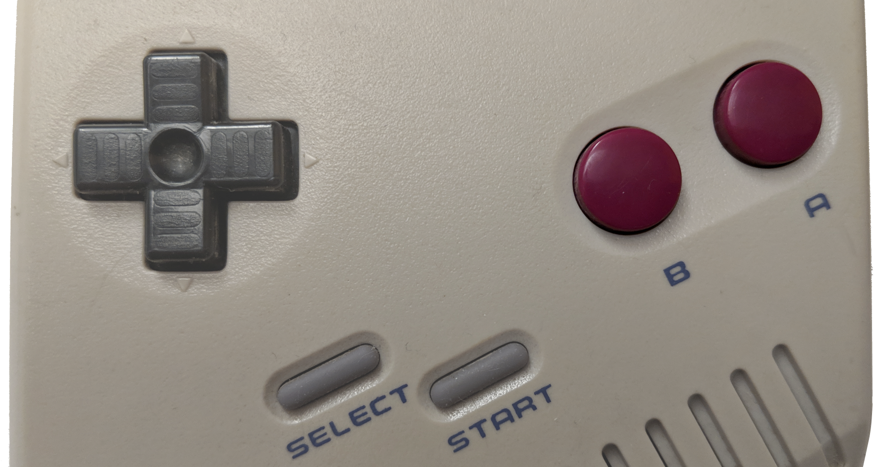
The Joypad
The joypad is very simple at the hardware level: it is composed of one single register, called P1_JOYP, that lives at 0xFF00
Bit | 7 | 6 | 5 | 4 | 3 | 2 | 1 | 0
Read/Write | N/A | N/A | Write | Write | Read | Read | Read | Read
Purpose | Unused | Unused | Select button keys | Select direction pad | Start or Down | Select or Up | B or Left | A or Right
A game can read the full joypad by doing the following:
write 0 to bit 5 and 1 to bit 4 // select buttons (0 is active)
read bits 0-3 // read buttons
write 0 to bit 4 and 1 to bit 5 // select d-pad
read bits 0-3 // read d-pad

Slide 61
Joypad Implementation
class Joypad : public IMemoryBusDevice {
...
void Update(float seconds) {
...
const auto pKeyState = SDL_GetKeyboardState(nullptr);
if ((P1_JOYP & Bit5) == 0) { // Buttons
SetBitValue(P1_JOYP, 0, pKeyState[SDL_SCANCODE_E] == 0); // A: E
SetBitValue(P1_JOYP, 1, pKeyState[SDL_SCANCODE_R] == 0); // B: R
SetBitValue(P1_JOYP, 2, pKeyState[SDL_SCANCODE_Q] == 0); // Select: Q
SetBitValue(P1_JOYP, 3, pKeyState[SDL_SCANCODE_W] == 0); // Start: W
}
if ((P1_JOYP & Bit4) == 0) { // D-pad
SetBitValue(P1_JOYP, 0, pKeyState[SDL_SCANCODE_RIGHT] == 0);
SetBitValue(P1_JOYP, 1, pKeyState[SDL_SCANCODE_LEFT] == 0);
SetBitValue(P1_JOYP, 2, pKeyState[SDL_SCANCODE_UP] == 0);
SetBitValue(P1_JOYP, 3, pKeyState[SDL_SCANCODE_DOWN] == 0);
}
}

Slide 62
Joypad Implementation
class Joypad : public IMemoryBusDevice {
...
virtual bool HandleRequest(MemoryRequestType requestType, Uint16 address, Uint8& value) {
switch (address) {
case Registers::P1_JOYP: {
if (requestType == MemoryRequestType::Write) {
// The incoming written value can only affect the top four bits of the P1_JOYP register
P1_JOYP = (P1_JOYP & 0x0F) | (value & 0xF0);
} else {
// return the current P1_JOYP register value
value = P1_JOYP;
}
return true;
}
break;
}
return false;
}

Slide 63
The LCD Controller
The Game Boy
The CPU
The Memory Bus
Cartridges and ROM
The Joypad
The LCD Controller
The Sound Controller
Other Bits

Slide 64

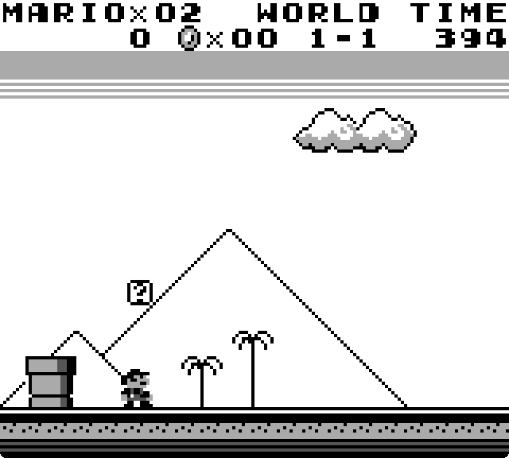
LCD Tiles
Like many consoles from that era, the Game Boy does not have a frame buffer
Instead, images are composed from 8x8 tiles which are combined into background and sprite layers
Tile map screenshot from BGB

Slide 65
LCD Layers
Three layers make up the final image
The background
Made up of tiles, which fill up the screen
Can be scrolled pixel-by-pixel
The window
Made up of tiles, which are displayed above the background
Can be positioned pixel-by-pixel
The sprites
Made up of 1x1 or 2x1 tiles
Can be displayed above or below the background and window
Up to a maximum of 40 sprites total, but a maximum of 10 per line

Slide 66
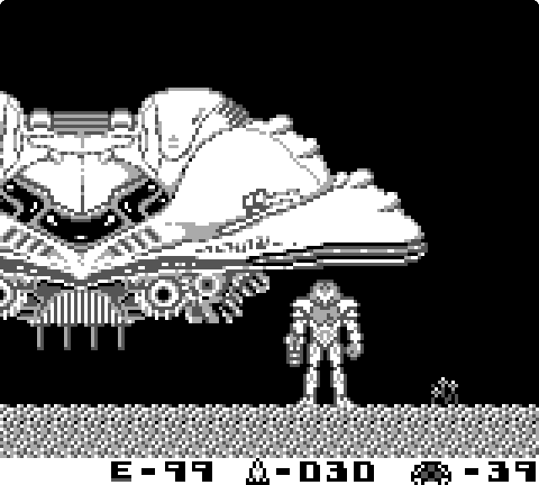
LCD Layer Example

Slide 67
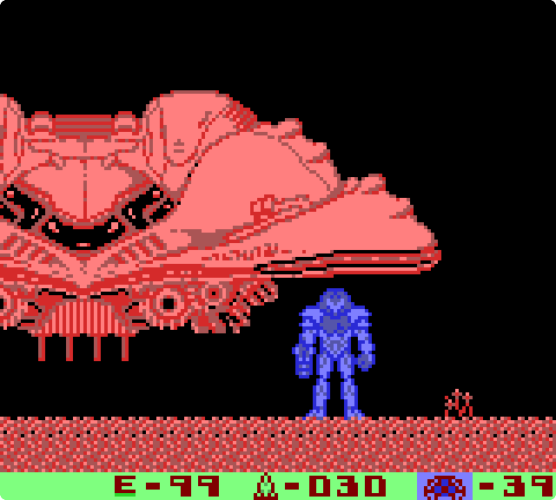
LCD Layer Example
Background
Window
Sprites

Slide 68
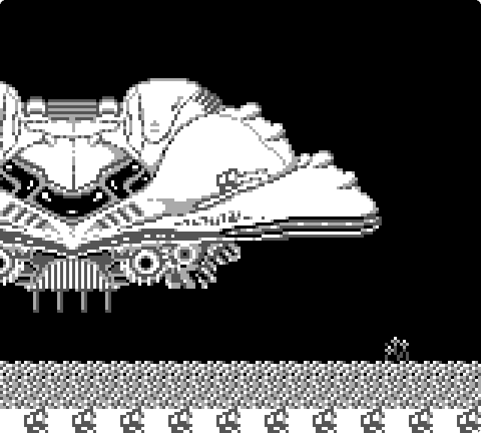
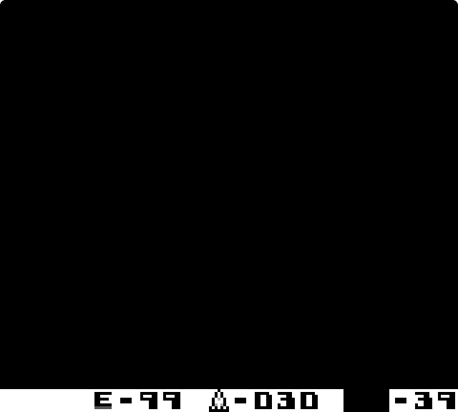
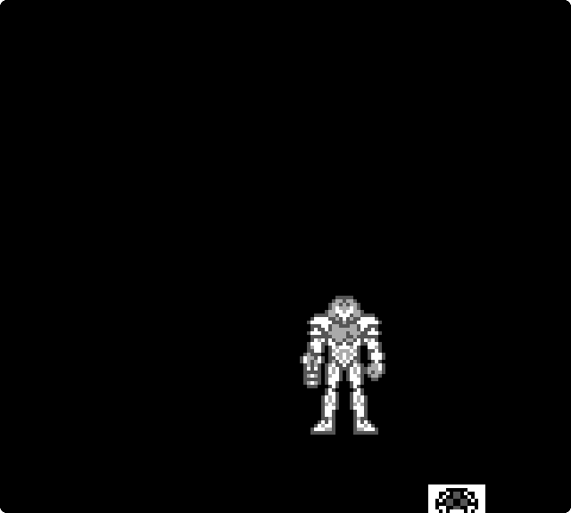
LCD Layer Example
Background
Window
Sprites

Slide 69
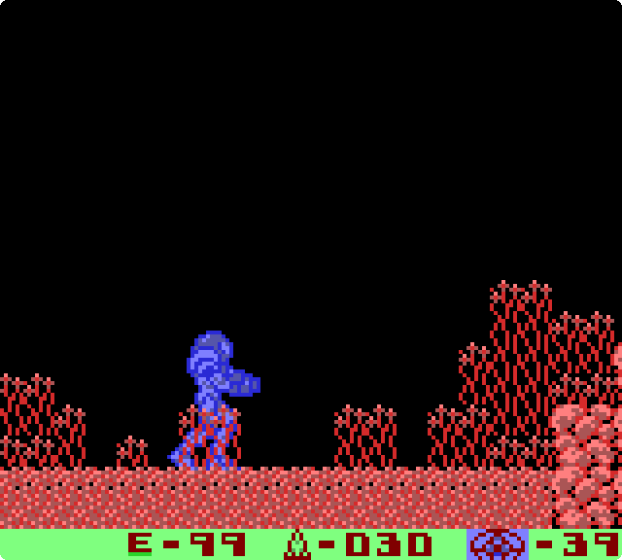
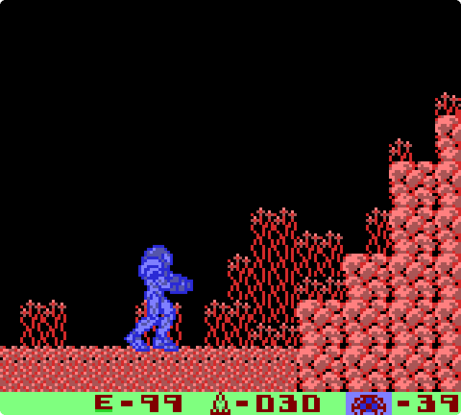
LCD Layer Tricks
Games can use layer sorting to give intricate illusions
E.g. Metroid 2 frequently toggles layer ordering to create an illusion of depth
Samus is behind the plants
A few steps over, Samus is in front of the plants

Slide 70
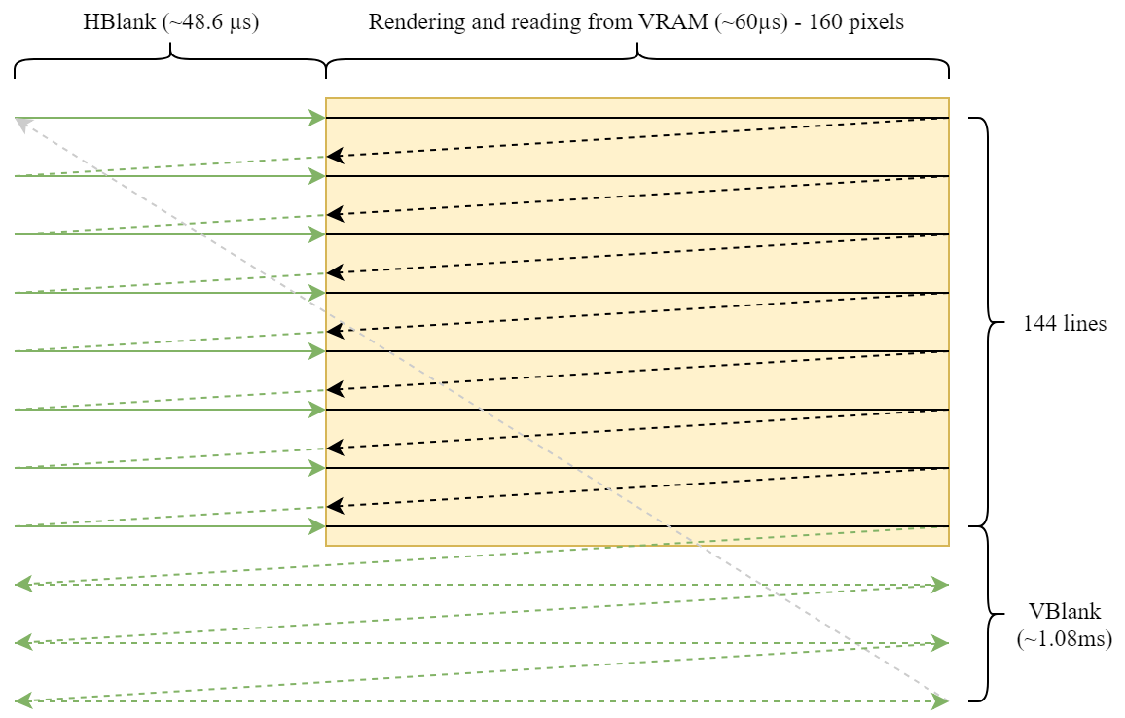
LCD Controller Timing
Though there is no physical need for it, the LCD controller implements a CRT-like line-by-line tracing pattern
This allows software to change the contents of VRAM on every line during HBlank, and on every frame during VBlank

Slide 71

LCD Controller Timing
This allows for many popular scanline tricks which involve leveraging the HBlank interval to change the layout of visible tiles between every drawn line

Slide 72
LCD C++ Implementation
The LCD controller implementation is straightforward, and there is no real magic
All of it fits in <700 lines of Allman/BSD-style C++
HBlank/VBlank timing is implemented using a simple explicit state machine
When VBlank is hit, the finished frame is presented to the user
Rendering is handled one full scanline at a time, since the CPU can’t alter any memory during that time
Mainly two operations
Array indexing computations to figure out what pixels go where
Lots of bit/flag testing to figure out the relative priorities, horizontal/vertical flips, etc.

Slide 73
The Sound Controller
The Game Boy
The CPU
The Memory Bus
Cartridges and ROM
The Joypad
The LCD Controller
The Sound Controller
Other Bits

Slide 74
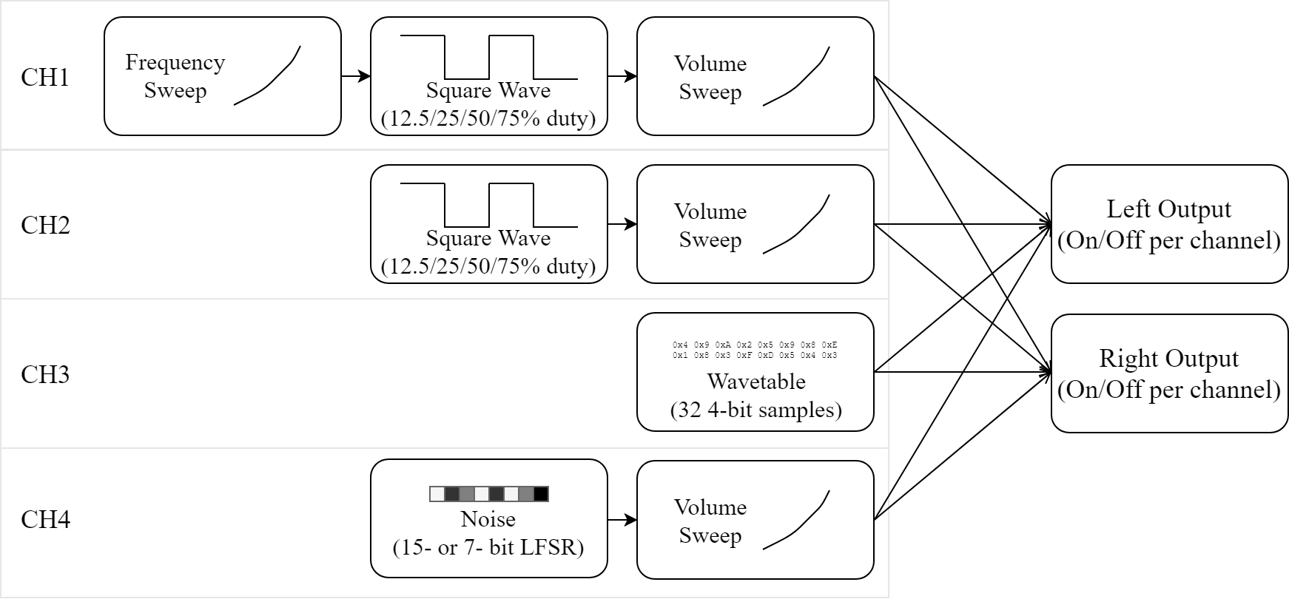
Sound Controller

Slide 75
Sound Controller
Four sound channels

Slide 76
Sound Controller
Two variable-duty square wave generators

Slide 77
Sound Controller
A noise generator

Slide 78
Sound Controller
A small sample-based generator (32 4-bit samples)

Slide 79
Sound Controller
One frequency sweeper, which alters the frequency of a generator up or down over time

Slide 80
Sound Controller
Three volume sweepers, which alter the volume of a channel up or down over time

Slide 81
Sound Controller
A final mixer allows the game to select which channels go to the left and right stereo outputs

Slide 82
Sound Controller C++ Impl.
Ironically, the sound controller code is quite a bit longer and more complex than the LCD code, because there are a lot of little details to get right
There are small classes for each of the components in the sound controller - FrequencySweep, VolumeEnvelope, SquareWaveGenerator, NoiseGenerator, etc.
Each does a little bit of work, and their outputs are all appropriately combined together
SDL is used to output audio
When it is low on samples, it asks the emulator for a new batch of 1024 samples

Slide 83
Other Small but Important Bits
The Game Boy
The CPU
The Memory Bus
Cartridges and ROM
The Joypad
The LCD Controller
The Sound Controller
Other Bits

Slide 84
The Timer
The timer is a very simple piece of circuitry built around a counter
The counter continuously increments at a chosen frequency
When the timer counter overflows, it fires a CPU interrupt
The exact time period between overflows/interrupts is configurable

Slide 85
DMA Transfer
Inside the LCD controller, there is a small Direct Memory Access (DMA) controller that can perform block memory transfers to VRAM
Given a source address, the DMA controller will copy 160 bytes to the area of VRAM that controls the sprite positions and layouts
With careful programming, this can be used to alter the sprite layout mid-frame and display more than 40 sprites on the whole screen
E.g. 40 sprites in the top half of the screen, and another 40 in the bottom half

Slide 86
Game Link Port
The Game Link port is a simple serial port, mainly used for multiplayer
Transfers are byte-sized with no start, stop, or parity bits
Transfers occur in full duplex - that is, a byte is shifted out while another is shifted in from the outside world
The bit clock can be internal or external (e.g. another Game Boy)
For the DMG-01, transfer rate is about 1 KiB/s

Slide 87

Conclusion
Emulator source is here: https://github.com/raptorofaxys/GBEmu
Slides: https://goo.gl/jQQY3c
If you want to write your own emulator, look online for documentation concerning your system of choice - chances are somebody’s already done a lot of reverse-engineering
If you are looking for a simple starting point, look into CHIP-8
Hack away!

Slide 88
Quick Shout-Outs
Huge thanks to Antonio Maiorano and Dominic Hudon for help reviewing and correcting the talk material!
Thanks to Antonio Maiorano, Dominic Hudon, Jean-François Pérusse and Antoine Bouchard for many interesting emulation-related discussions!
As usual, a huge thanks to my spouse Laurence Sylvestre-Tardif for putting my with my antics :-)

Slide 89

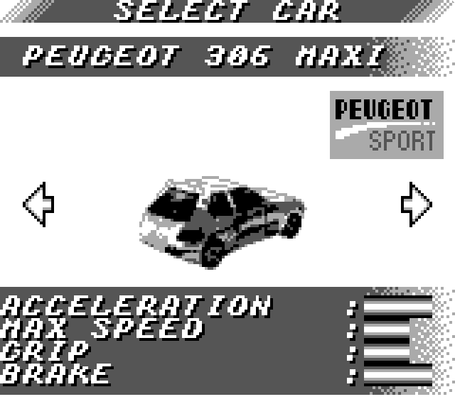
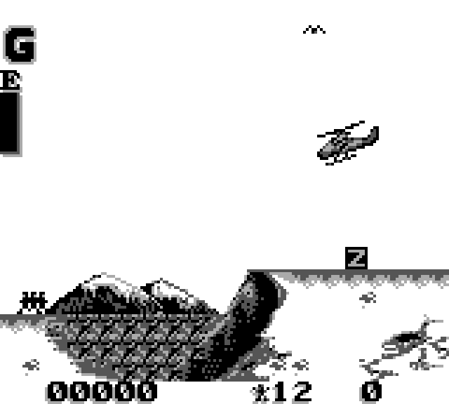
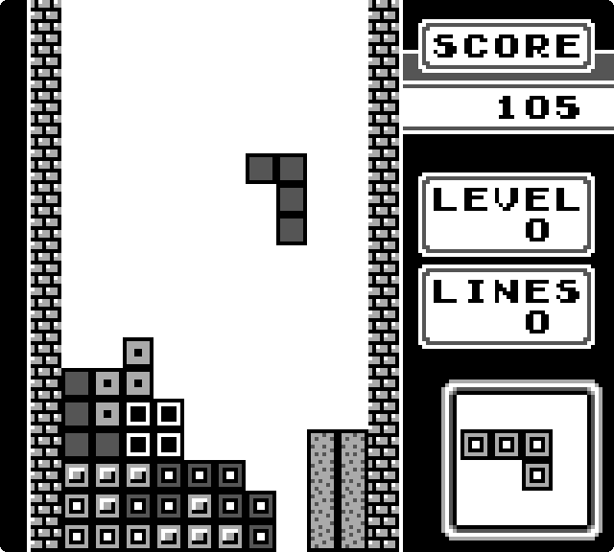
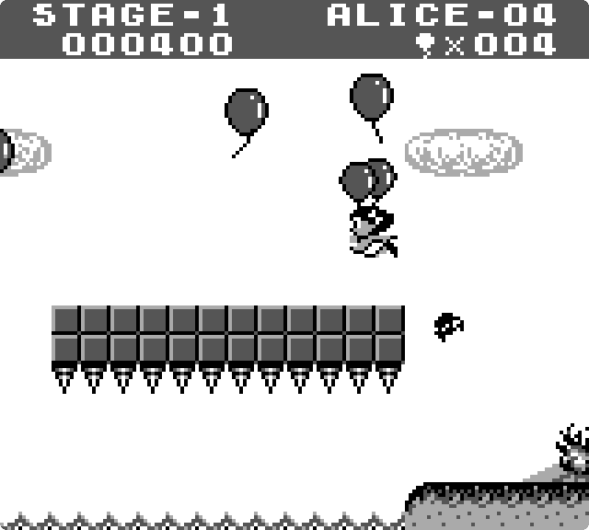
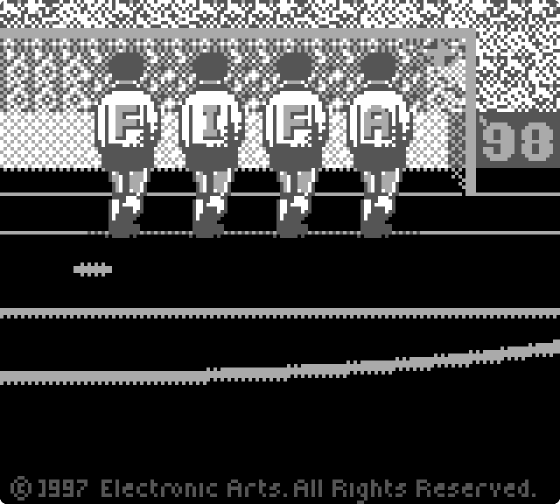
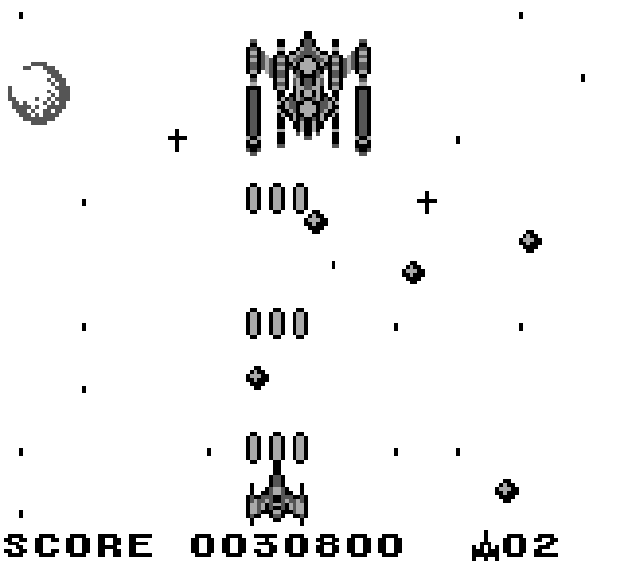
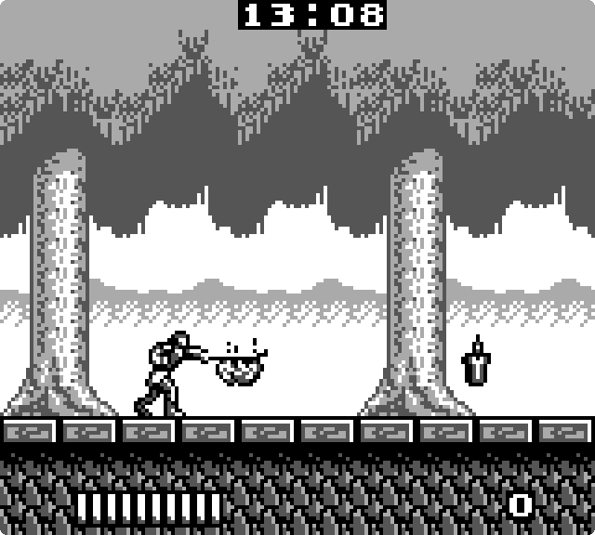


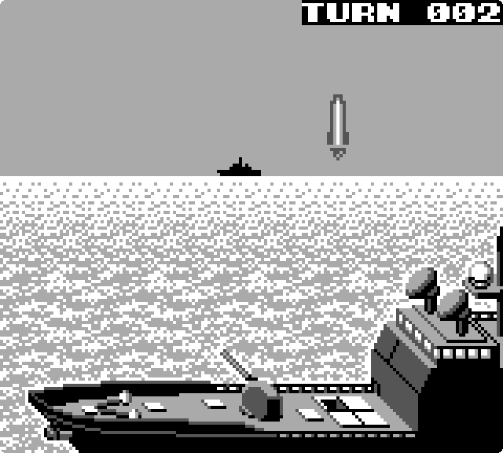
Thank You!
Questions?

